Slide 1
EUDAT
Data Services for Research
“The Story”
Per Öster
Director, Research Infrastructures
CSC – IT Center for Science Ltd

Slide 2
The Issue
Why EUDAT?

Slide 3




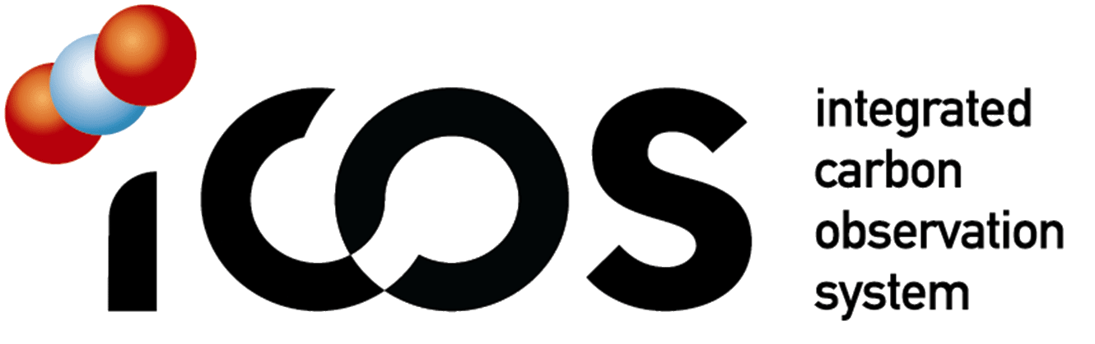








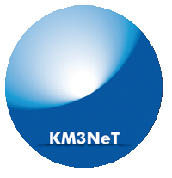





















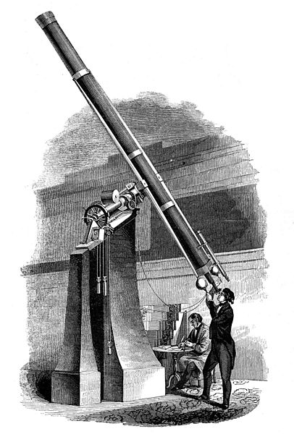
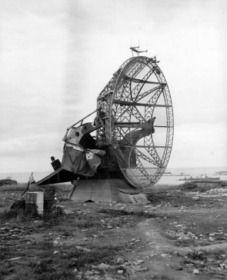

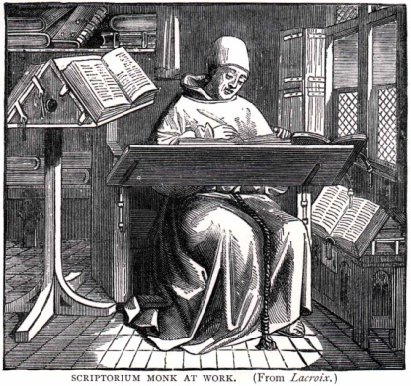
Research - Collaborations - Infrastructures
Research Infrastructure trends:
Internationalisation
Professionalization
Increasing dependence on ICT
The data deluge
European Ris:
Around 500
€ 100 billion investment
middle age 19th century 20th century 21st century

Slide 4
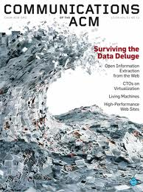

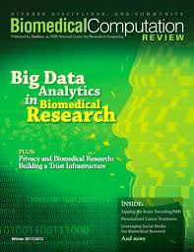
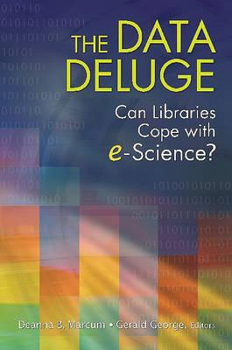
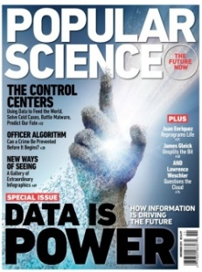

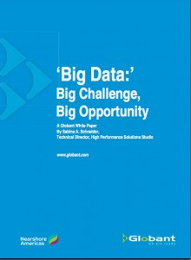
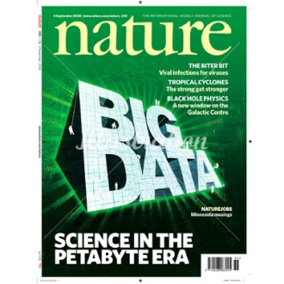
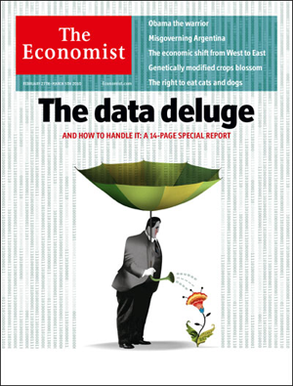

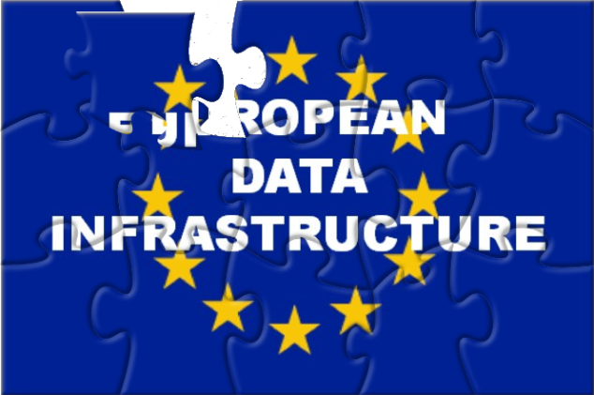
Pan-European RI data challenges requires pan-European solutions
All Research Infrastructures are facing data challenges
  How to store the growing amount of data?
  How to find it?
  How to make the most of it?
Many communities are developing own solutions
  This is good…
  … but we also need to make sure that the solutions remain interoperable
EUDAT mission is to fill this gap
  Providing a set of services to help RIs managing their growing amount of data
  Providing these services across communities to ensure minimum level of interoperability
  EUDAT also help to bring data and computing together (HPC centers core partners)

Slide 5
The Background
First some history

Slide 6
History of the EUDAT concept
Early consortium of 13 European partners (mostly service providers with expertise in HPC, grid computing, networking and data storage)
EUDAT has its origins in the work of the PARADE (Partnership for Accessing Data in Europe) initiative
  PARADE White Paper (September 2009) defining a Strategy for a European Data Infrastructure that should be persistent, multidisciplinary, and based on the need of user communities
  The concept of a shared pan-European infrastructure was then supported and further elaborated by a number of policy and experts bodies:
    e-IRG and ESFRI: e-IRG Blue Paper (September 2010) recommends ”to identify and promote common (long term) data related services across different RI”
    High Level Expert Group (HLEG) report on Scientific Data: ”Riding the Wave: How Europe can gain from the rising tide of scientific data” (October 2010) calls for a ”Collaborative Data Infrastructure” for scientific data, that supports seamless access, use, reuse, and trust of data

Slide 7
EC e-Infrastructure Vision (~2005)
* Slide by European Commission, DG CNECT e-Infrastructure unit Kyriakos Baxevinidis

Slide 8


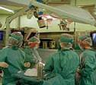






Building the Generic Data Infrastructure Layer
e-Infrastructures Vision
empower research communities through ubiquitous, trusted and easy access to services for data, computation, communication and collaborative work
physics community
biomedics community
astronomy community
Sharing and federating scientific data
Sharing computers, software and instruments
Linking at the speed of the light
Scientific facilities, research communities
. . . . . . .
••• 8
Notes:
8

Slide 9
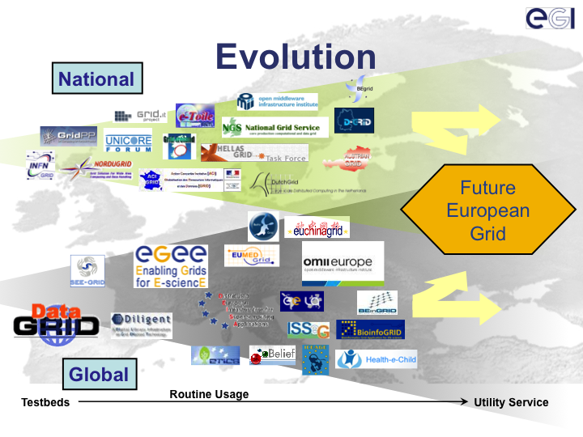




~2000
2008
Today
Timeline

Slide 10
The analysis
About the big picture, EUDAT and EUDAT 2020

Slide 11
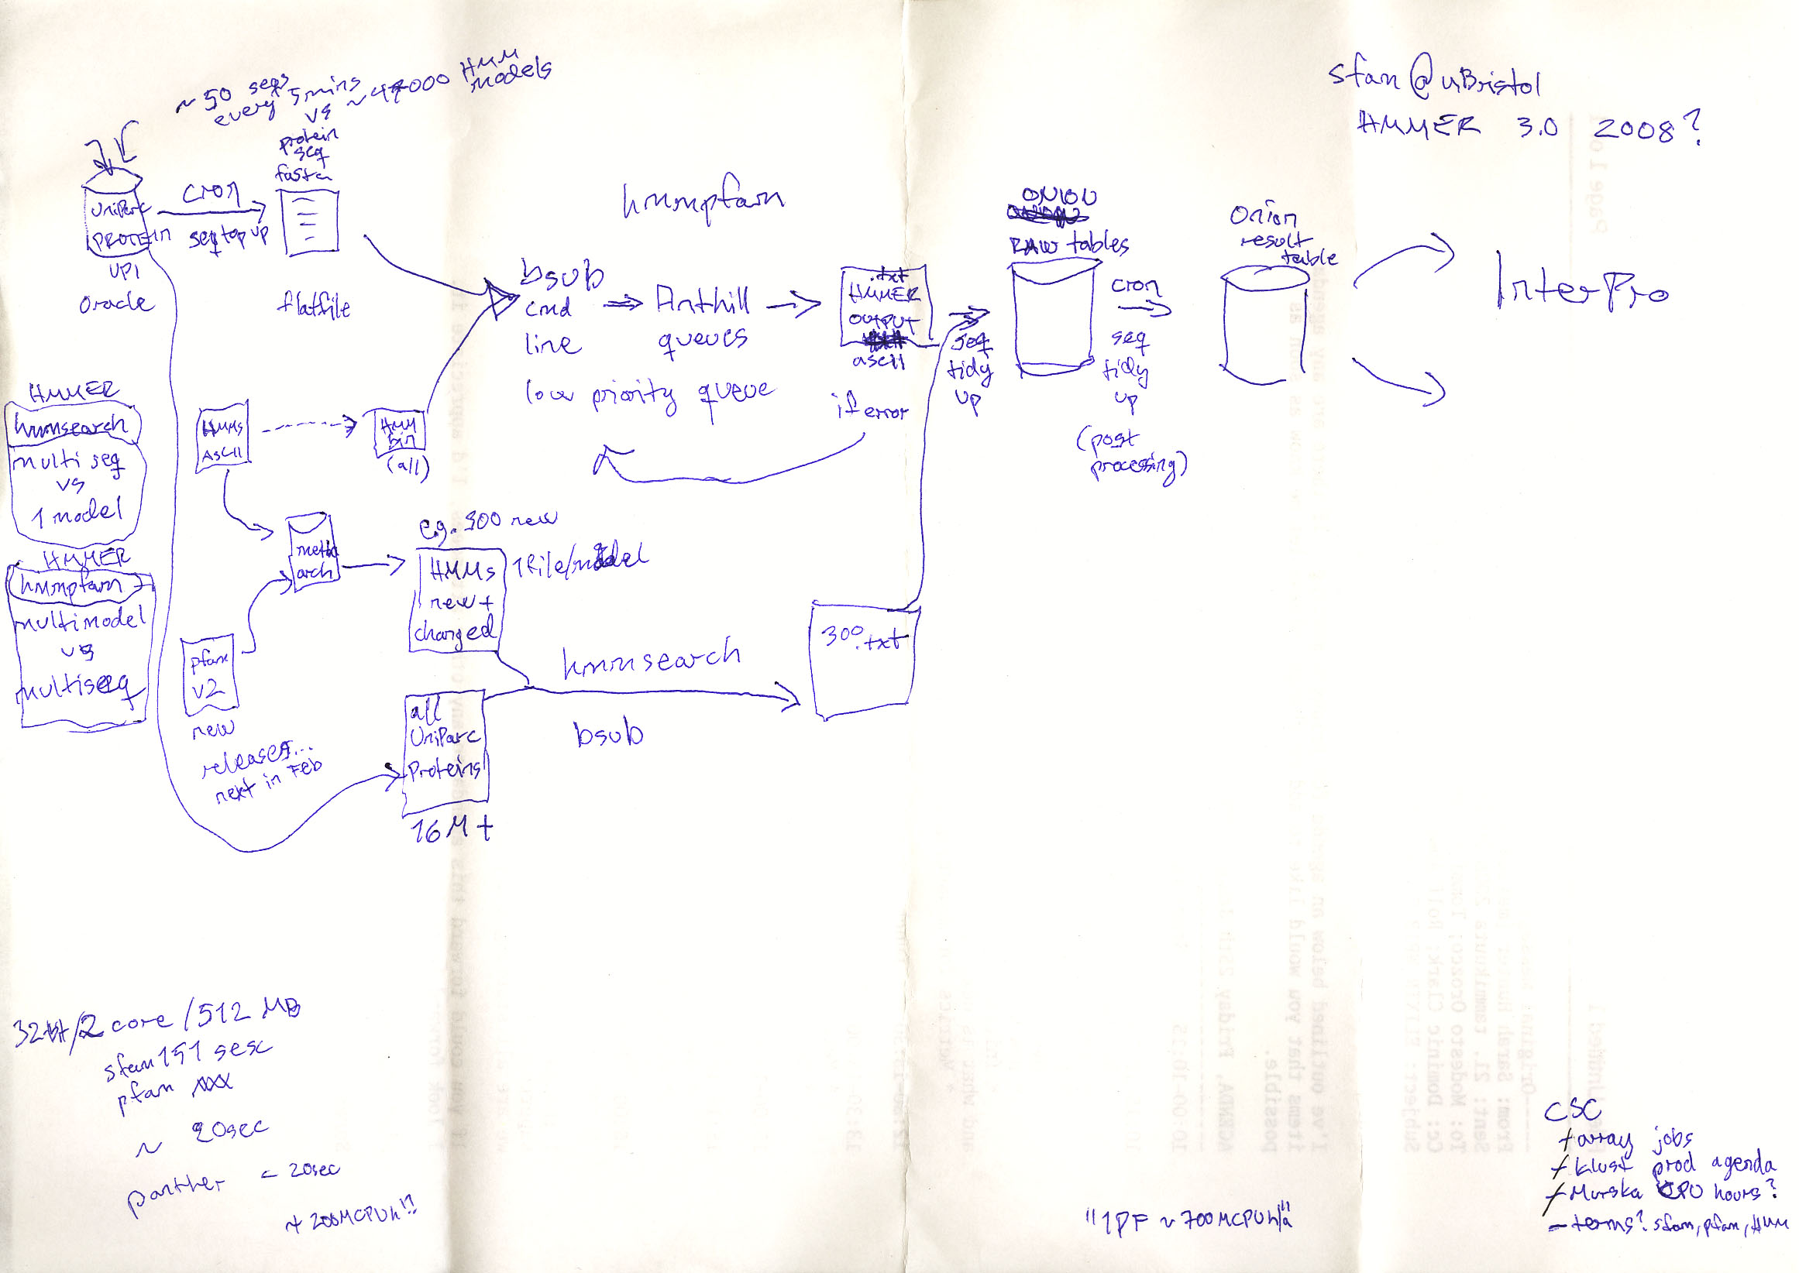
Complex Collaborations – Complex Workflows
Complex workflows encompassing experimentation, simulation, analysis and publication!
Data is the asset

Slide 12
Research Infrastructures – Where is it going?
Research Infrastructure trends:
Internationalisation
Professionalization
Increasing dependence on ICT
The data deluge
European Ris:
Around 500
€ 100 billion investment
middle age 19th century 20th century 21st century

Slide 13
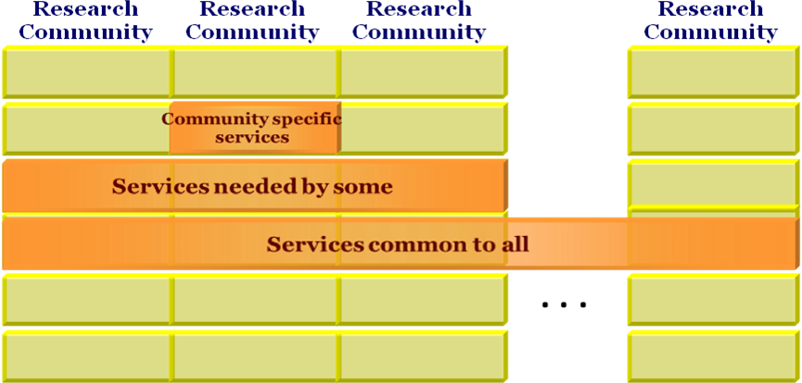
We need to promote synergy
The worst case scenario: 500 RI with 500 incompatible self-made ICT and data management solutions
What can we do to promote collaboration and re-use of e-infrastructure?
EVERY RI NEEDS TO DEAL
WITH DATA MANAGEMENT

Slide 14






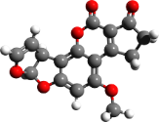
Integrating e-Infra and RIs
Research Infrastructures → CDI users, partners & stakeholders
It is not only about developing technical solutions, but also about defining the right partnership model
  The model must necessarily take into account existing arrangements within pan-European research communities (organisational structure, funding schemes, business models, etc.)

Slide 15
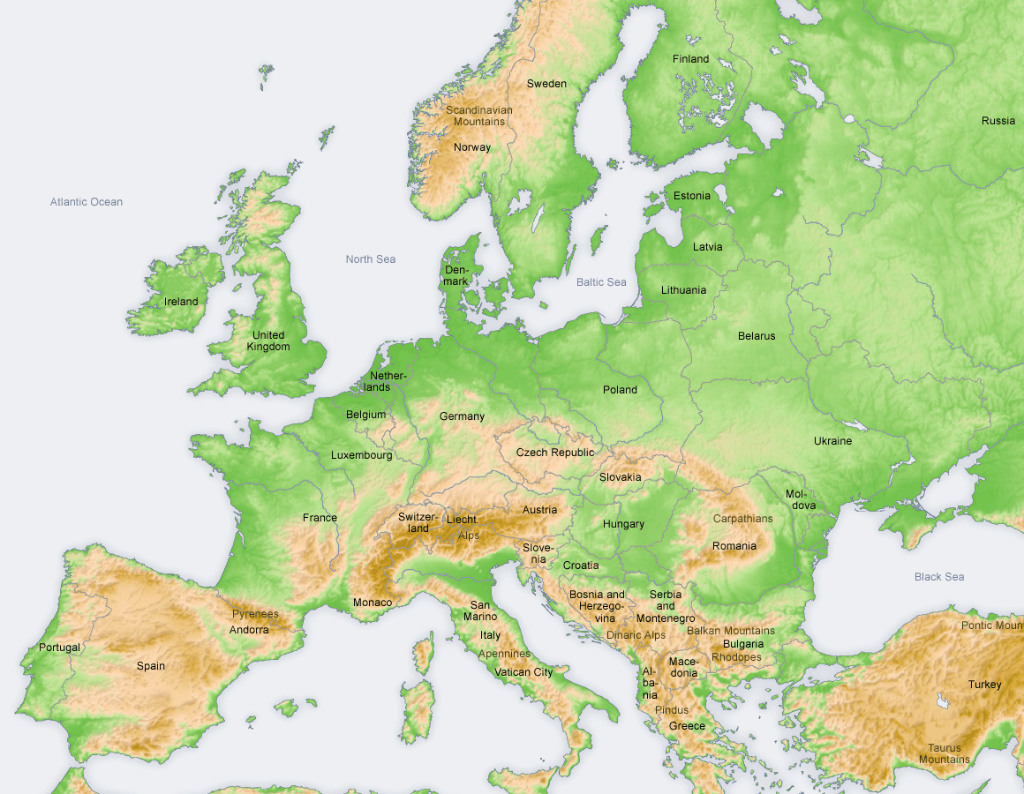


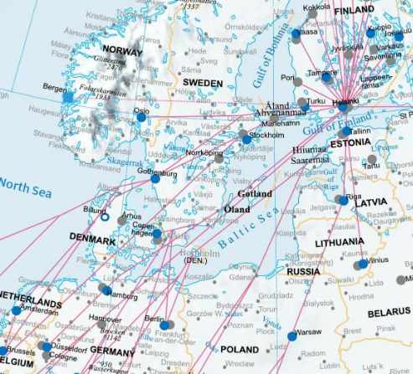
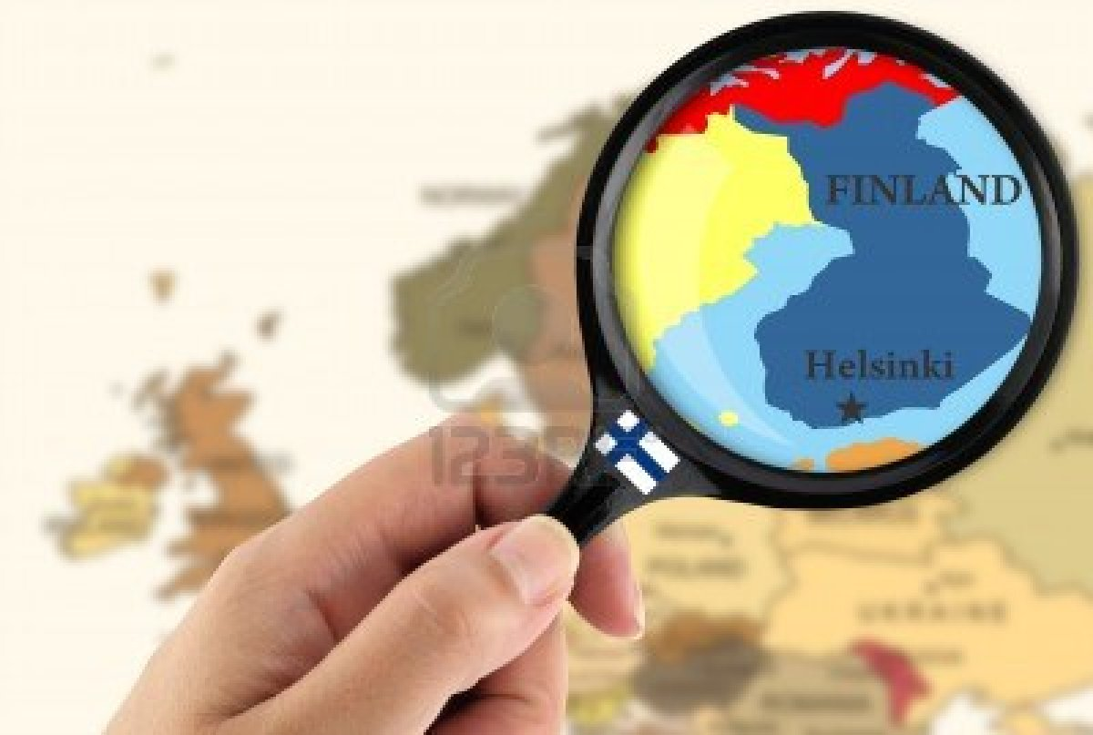
Bridging National and European solutions
  Research and infrastructures are still funded at national levels → need to make sure that the solutions remain interoperable
EUDAT provides a European gateway to national centers and a European extension to national solutions
Making national resources more available and visible
  Access to European resources through national catalogues
  Making visible valuable national collections through EUDAT

Slide 16


E-Infrastructure Commons
Think about the users… and all these acronyms!
  Users should have a “right” to a seamless access to network, data, and computing resources funded by public money
  It is our role to make it as easy as possible for users →No one should care about e-Infrastructures as such
Think global!
  Solutions must also be thought at global level (RDA)
  Cross-continent collaboration is a must (e.g. NDS, ANDS, etc.)

Slide 17
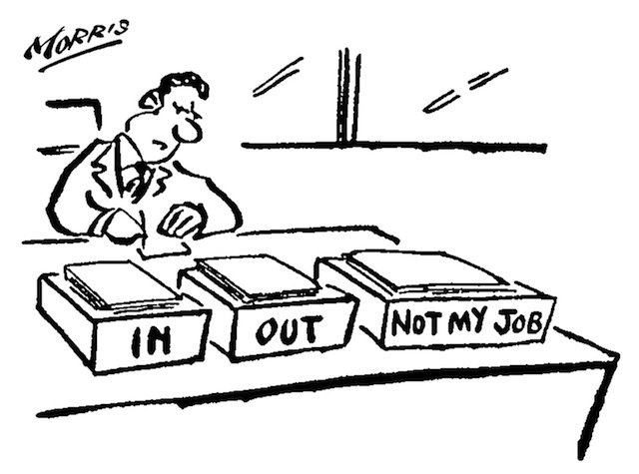
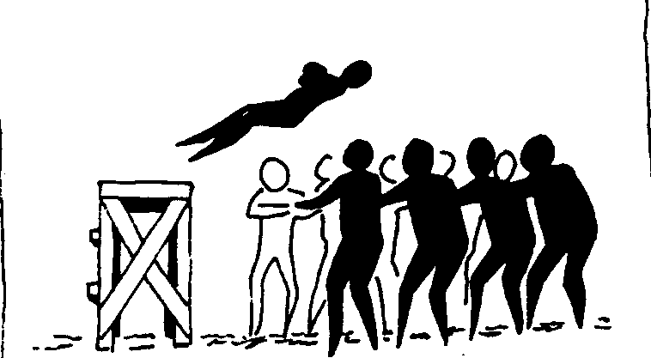
Roles and Responsibilities
Agreeing on roles and responsibilities
  Between RIs and e-Infrastructures
  Between e-Infrastructures (EUDAT, EGI, PRACE, OpenAIRE, etc.)
  Between national and European e-Infrastructures
  Between funders (EC/National)
Trust is key!
Agreeing on roles and responsibilities
  Between RIs and e-Infrastructures
  Between e-Infrastructures (EUDAT, EGI, PRACE, OpenAIRE, etc.)
  Between national and European e-Infrastructures
  Between funders (EC/National)
Trust is key!

Slide 18
Customers and Flavour of the Currency
Need to evolve
for sustainability
Service
RI, Researchers
Excellence,
Effort, Policy
Service
Service
NGI, RI,..
RI, Researchers
€, Effort,
Resources
€, Policy,
Resources
Service
Researchers
Excellence
Service
Service
NRENs, RI
Universities
Institutes,…
€
€

Slide 19

Follow the Money
Funding of research
  Funding streams
  Spending restrictions
  Procurement rules
  Policy for RI use
  Policy for e-Infra use
Governments
€
European Commission
€
RI
(ERIC, EIRO,..)
€
€
e-Infra
€
Service
Sustainability?
€?
Knowledge Exchange
sustainability index

Slide 20
The Solution
EUDAT and EUDAT2020

Slide 21




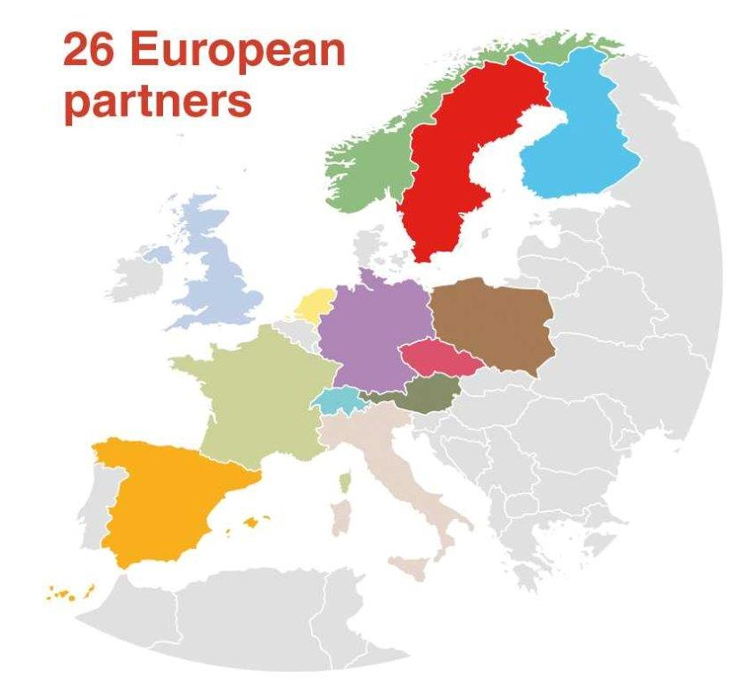






















Consortium

Slide 22
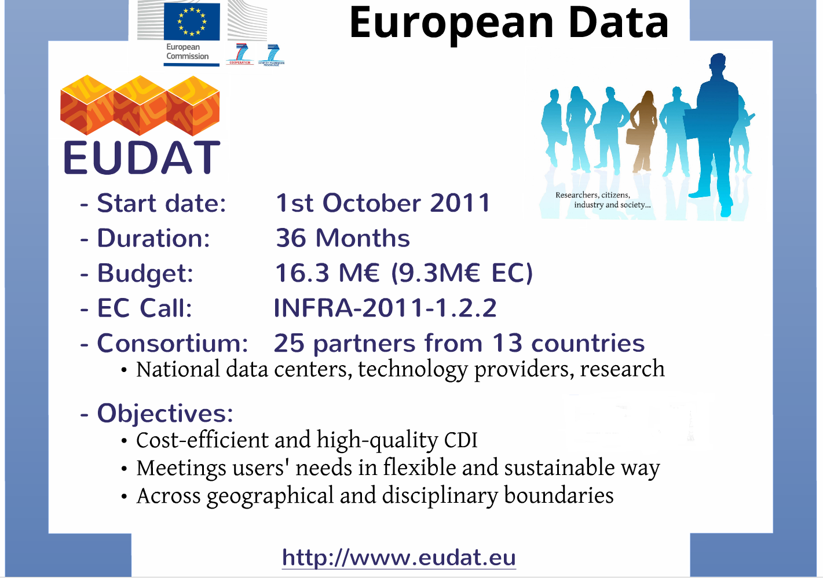

Slide 23
Sustainable
Independent and sustainable centres working within a common framework to develop shared services & policies
EUDAT is about providing solutions in a federated environment
Partnerships between legal entities relying on OLAs and SLAs
General data
centres
Community
data sites

Slide 24






Service-Oriented
Covering both access and deposit, from informal data sharing to long-term archiving, and addressing identification, discoverability and computability of both long-tail and big data, EUDAT services address the full lifecycle of research data
www.eudat.eu

Slide 25
New Proposal: EUDAT2020
More services (by user needs)
Strengthen collaboration between e-Infrastructures and Research Infrastructures
  Within EUDAT → update plans, partnership models, etc.
  Joint participations in projects (e.g. RI clusters)
Foster interoperability between pan-European infrastructures
  Pilot cross-infrastructure services
  E-Infrastructure Commons Roadmap
Bridge national and European solutions
  Build on success stories and working examples
  Establish partnership models for national stakeholders
Make Europe better integrated!
  Consolidate the infrastructure for academia and industry
  Establish innovative international collaboration

Slide 26
References and Acknowledgments
EGI Design Study, prof. Dr. Dieter Kranzlmueller
  Old e-infrastructure evolution slide
European Commission DG CNECT e-Infrastructure unit
  2005 e-Infrastructure vision slide
Dr. Tommi Nyrönen, Head of Finnish ELIXIR node
  Napkin with workflow
Dr. Damien Lecarpentier, EUDAT Project Director
  Almost all other slides
Knowledge Exchange Sustainability Index
  http://hdl.handle.net/11304/0b51c322-5938-11e4-81ac-dcbd1b51435e
Strategy for a European Data Infrastructure (PARADE White Paper)
  …

Slide 27

Thank you

Slide 28
About the Services
Details of the EUDAT services for the interested

Slide 29

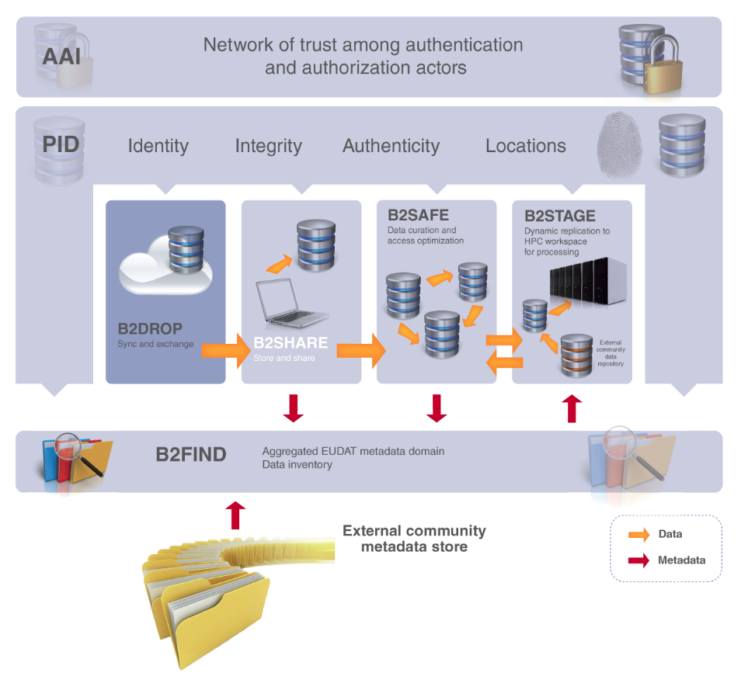

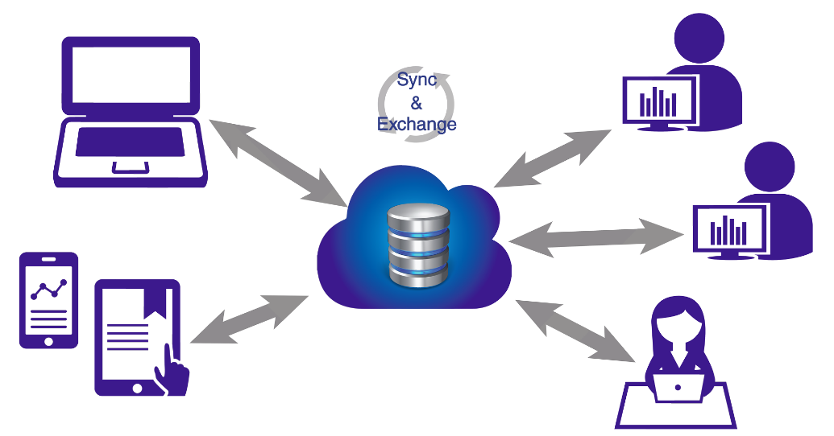

B2DROP is a secure and trusted data exchange service for researchers and scientists to keep their research data synchronized and up-to-date and to exchange with other researchers.
An ideal solution to:
b2drop.eudat.eu
Store and exchange data with colleagues and team
Synchronize multiple versions of data
Ensure automatic desktop synchronization of large files

Slide 30
B2DROP features
b2drop.eudat.eu
future integration with the B2 suite of services to allow user-friendly data sharing
users decide with whom to exchange data, for how long and how
up to 20GB of storage space for research data
access and manage permissions to files from any device and any location
simple to use and open to all researchers, scientists, communities alike to synchronize and exchange data with one or multiple users

Slide 31


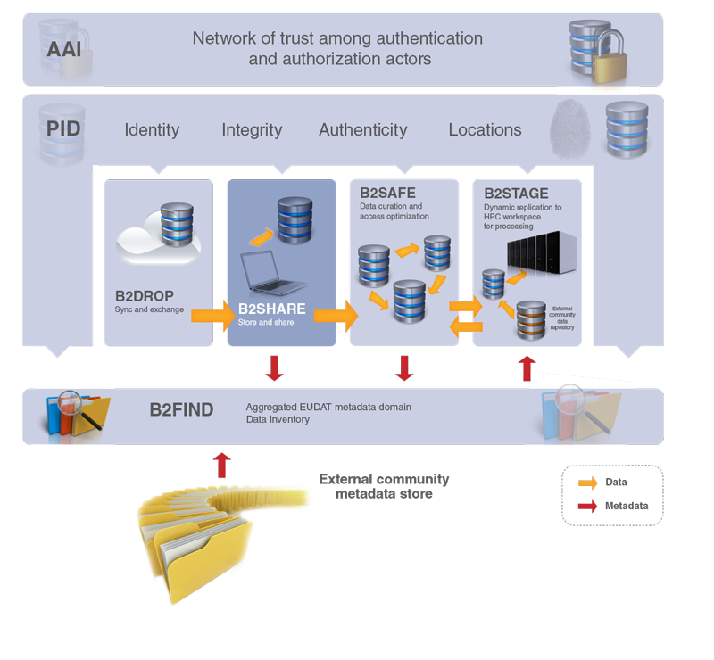
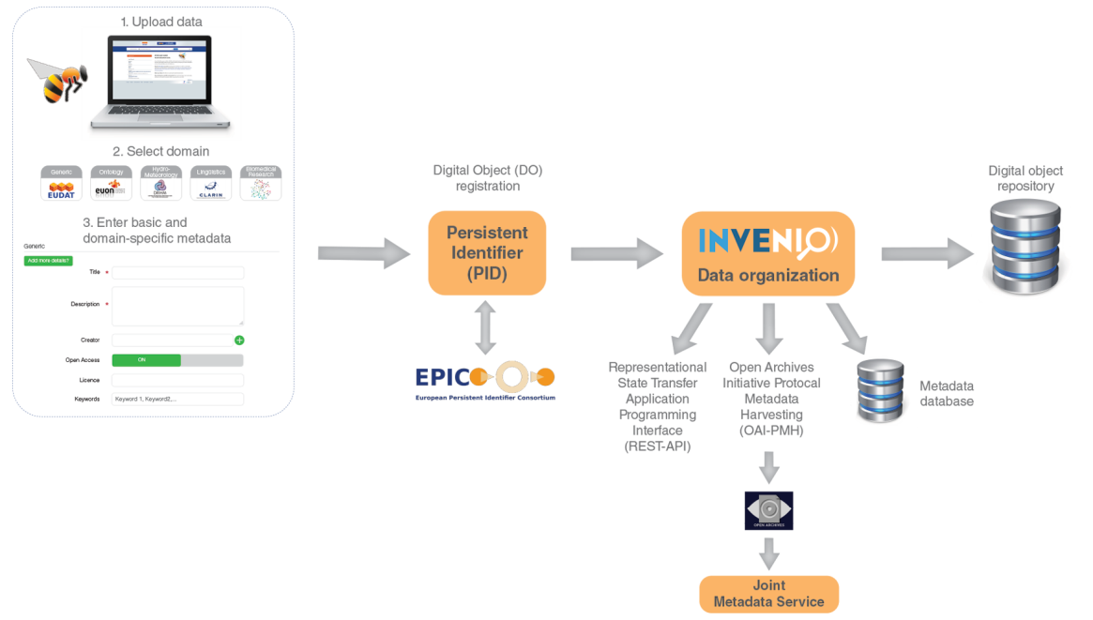
B2SHARE is a user-friendly, reliable and trustworthy way for researchers, scientific communities and citizen scientists to store and share small-scale research data from diverse contexts.
A winning solution to:
b2share.eudat.eu
Store: facilitates research data storage
Preserve: guarantees long-term persistence of data
Share: allows data, results or ideas to be shared worldwide

Slide 32
B2SHARE features
b2share.eudat.eu
integrated with the EUDAT collaborative data infrastructure
free upload and registration of stable research data
data assigned a permanent identifier, which can be retraced to the data owner
data owner defines access policy
community-specific metadata extensions and user interfaces
openly accessible and harvestable metadata
representational state transfer application programming interface (REST API) for integration with community sites
data integrity ensured by checksum during data ingest
professionally managed storage service – no need to worry about hardware or network
EUDAT user support
monitoring of availability and use

Slide 33

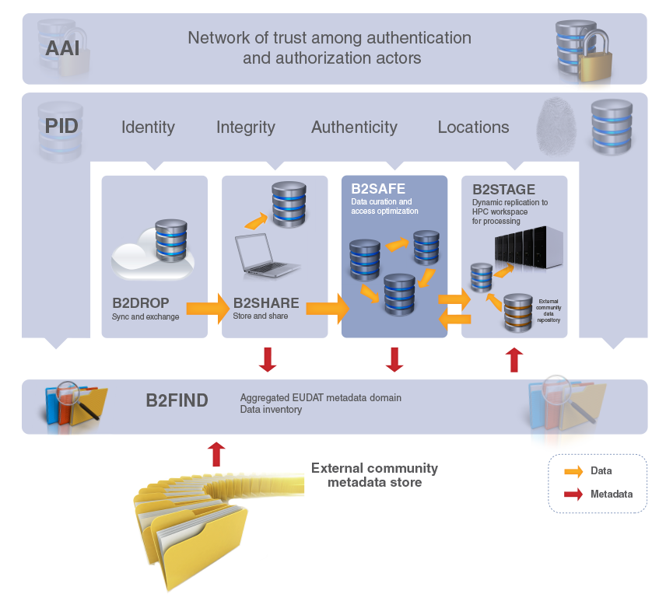
B2SAFE is a robust, safe and highly available service which allows community and departmental repositories to implement data management policies on their research data across multiple administrative domains in a trustworthy manner.
A solution to:
eudat.eu/b2safe
Provide an abstraction layer which virtualizes large-scale data resources
Guard against data loss in long-term archiving and preservation
Optimize access for users from different regions
Bring data closer to powerful computers for compute-intensive analysis

Slide 34
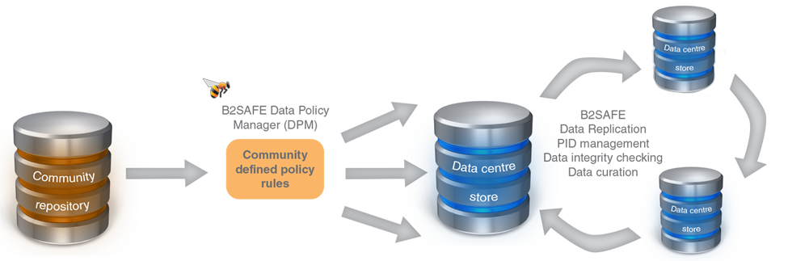
B2SAFE features
eudat.eu/b2safe
based on the execution of auditable data policy rules and the use of persistent identifiers (PIDs)
respects the rights of the data owners to define the access rights for their data and to decide how and when it is made publicly referenceable
data policies are centrally managed via a Data Policy Manager, and the policy rules are implemented and enforced by site-local rule engines
able to aggregate data from different disciplines into a storage system of trustworthy and capable data service providers
support for repository packages (e.g. DSPACE, FEDORA) and a lightweight HTTP-based solution

Slide 35
Who benefits
eudat.eu/b2safe
repositories lacking the capacity and / or funding to offer reliable storage and access services over longer periods of time
repositories without adequate compute capacity for data-intensive computational services based on their data
data producers who need to be sure that trusted centres are taking care of their data
consumers wishing to access optimized services on data sources of interest to them
consumers who wish to apply interdisciplinary data-intensive methods using data collected from various communities

Slide 36

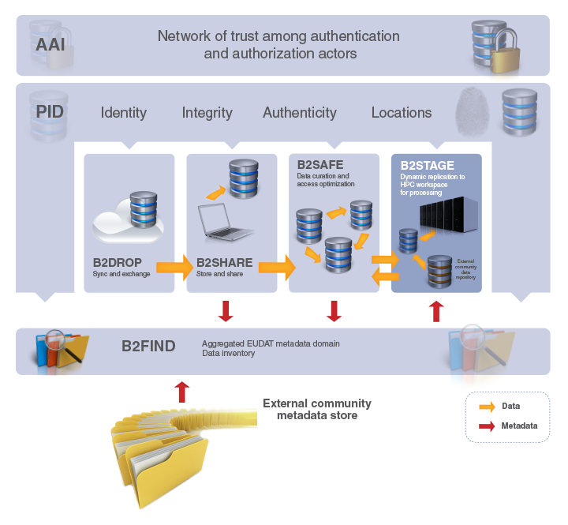
B2STAGE is a reliable, efficient, light-weight and easy-to-use service to transfer research data sets between EUDAT storage resources and high-performance computing (HPC) workspaces.
The service allows users to:
eudat.eu/b2stage
Transfer large data collections from EUDAT storage facilities to external HPC facilities for processing
In conjunction with B2SAFE, replicate community data sets, ingesting them onto EUDAT storage resources for long-term preservation
Ingest computation results into the EUDAT infrastructure
Access data through a RESTful HTTP interface (in progress)

Slide 37
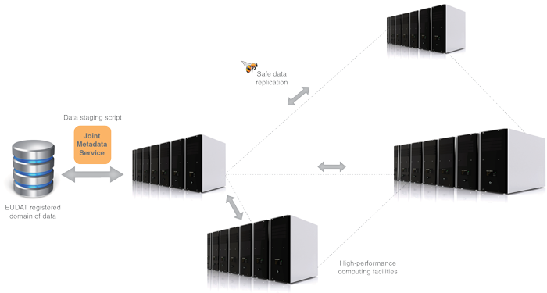
B2STAGE features
an extension of the B2SAFE and B2FIND services, which allow users to store, preserve and find data
data-staging script facilitates staging, ingestion and retrieval of persistent identifier (PID) information of transferred data
service available to all registered researchers and interested communities
eudat.eu/b2stage
users negotiate access to remote HPC services in parallel
collaboration with other infrastructures, such as the European Grid Infrastructure (EGI) and Partnership for Advanced Computing in Europe (PRACE)
documentation, educational material and service helpdesk available to support users

Slide 38

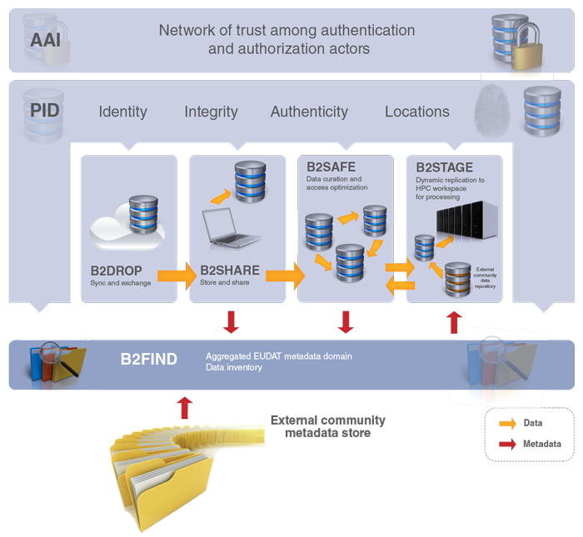
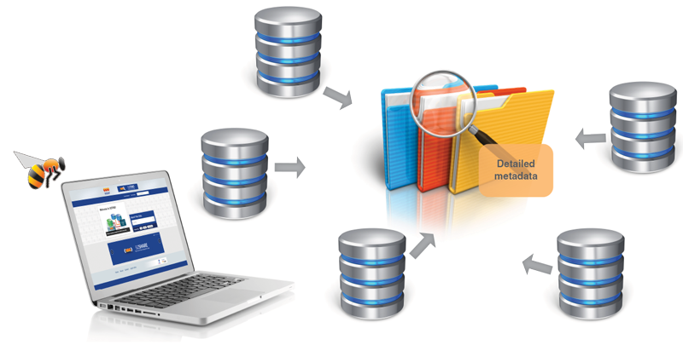
B2FIND is a simple, user-friendly metadata catalogue of research data collections stored in EUDAT data centres and other repositories.
A service which allows users to:
b2find.eudat.eu
Find collections of scientific data quickly and easily, irrespective of their origin, discipline or community
Get quick overviews of available data
Browse through collections using standardized facets

Slide 39
B2FIND features
b2find.eudat.eu
based on a comprehensive joint catalogue of EUDAT services and external metadata
metadata is mapped onto standardized facets
supports faceted, geospatial and temporal metadata searches
allows users to search and browse datasets via keyword searches
results displayed in user-friendly format and listed in order of relevance
access to the scientific data objects is given through references provided in the metadata
initially available for communities in the EUDAT registered domain of data
EUDAT will then extend the service to other interested and reliable data and metadata providers

