Slide 1
Data Requirements of IEEE Authors
Kenneth Moore
NDS Consortium Planning Workshop, Boulder, CO, June 12-13, 2014

Slide 2
Survey shows 3 in 4 researchers believe in expanding access to data
Greater access to data accelerates scientific breakthroughs
Strongly disagree | 11 | 0.9%
-1 | 32 | 2.7%
0 | 163 | 13.9%
+1 | 312 | 26.7%
Strongly agree | 620 | 53.0%
Do not know/NA | 32 | 2.7%
Total | 1170 | 100.0%
78.7%
Source: IEEE Strategic Research, Data Storage and Authorship Survey Report, 2014

Slide 3
But only 3 in 5 support sharing of funded research data
Grant-funded research should be freely shared
Strongly disagree | 39 | 3.3%
-1 | 118 | 10.1%
0 | 258 | 22.1%
+1 | 327 | 28.1%
Strongly agree | 376 | 32.1%
Do not know/NA | 47 | 4.0%
Total | 1165 | 100.0%
60.2%
Source: IEEE Strategic Research, Data Storage and Authorship Survey Report, 2014

Slide 4
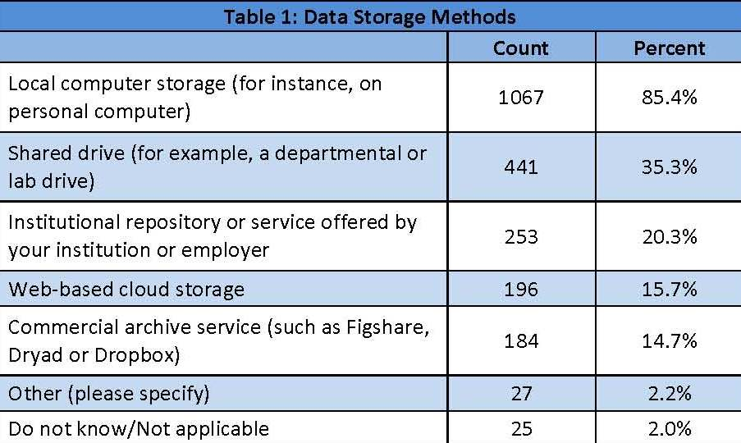
Research data is typically stored on a local or shared drive
Which of the following methods do you use to store your data? (Respondents could select more than one answer.)
1 in 5 use a repository
Source: IEEE Strategic Research, Data Storage and Authorship Survey Report, 2014

