Slide 1

[Data, data] every where..
Nor any drop to drink
- Samuel Taylor Coleridge
Notes:
Data, data, everywhere. And not a drop to drink
(pace Samuel Taylor Coleridge)

Slide 2

Data access might feel more like this
Notes:
In an otherwise parched land, we do have a few trees living and growing. Dryad and Dataverse being two examples in this land – repositories that are recreating the groundwork for what may otherwise be a thriving and abundant landscape one day.

Slide 3
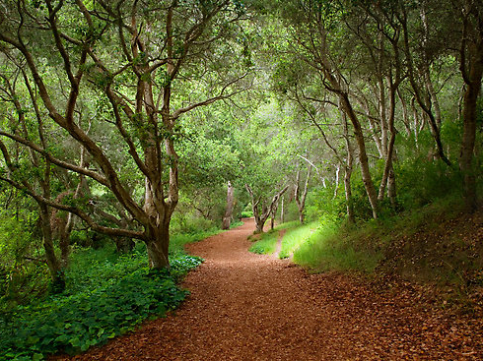
PLOS Data Access Policy Update
No barriers to enter.
All welcome.
All data underlying the published results should be fully available without restriction with rare exception and described in the article publication.
Notes:
1. PLOS journals require authors to make all data underlying the findings described in their manuscript fully available without restriction, with rare exception.
2. When submitting a manuscript online, authors must provide a Data Availability Statement describing compliance with PLOS’s policy. The data availability statement will be published with the article if accepted.
Acceptable data-sharing methods:
Data deposition (strongly recommended; must include DOIs or accession numbers )
Deposition in structured, subject-area repositorieswhere they exist, or catch-alls such as Dryad /FigShare
Data in supporting information files (in file format from which data can be efficiently extracted)
Possible alternatives, subject to case-by-case evaluation:
Data made available to all interested researchers upon request (only where deposition is not ethical or legal, eg, studies involving human participants; NOT from the authors themselves but from an ethics or oversight committee)
Data available from third party (only where authors did not generate the primary dataset themselves but it is available)
Specification of restrictions unacceptable to PLOS
Author refusal to share because of personal reasons such as patents or future publications
Analysis rests solely on proprietary data: If proprietary data are used, the manuscript must include an analysis of public data that validates the conclusions so others can reproduce the analysis and build on the findings
“data not shown”
Failure to comply
May affect decision to consider or to publish the manuscript
If after publication researchers cannot obtain data, PLOS may publish a correction, contact authors' institutions and funders, or in extreme cases withdraw publication

Slide 4

C
New Social Contract
Notes:
Development of new data access policy over > 1 year
Steering committee included staff plus journal editors who are also active researchers
Data policy committee involving individuals from, and communicating with, all levels of journal review and production
Presentations at conferences and meetings
Consultations with editorial boards
Review of policy iterations and communications before public release
Pre-implementation questions from researchers
What to do with massive datasets?
What if the researcher plans to publish additional studies using the data?
What if competitors take advantage?
In cases of “data available on request,” what if no data access committee exists and the IRB is not willing to take on the responsibility?
Concerns over privacy for human data

Slide 5
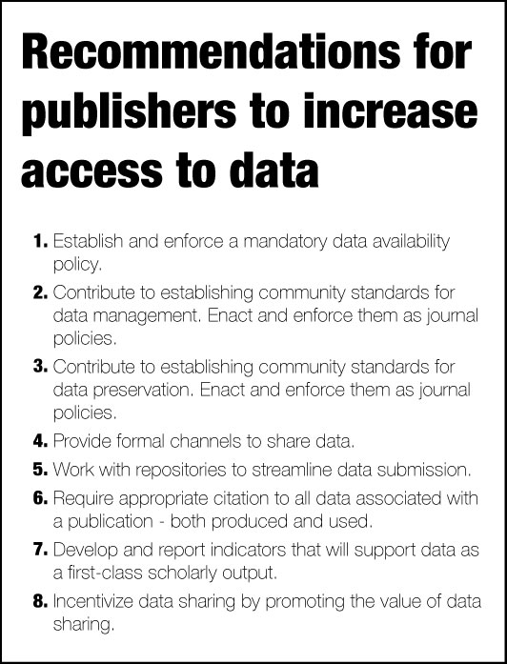
“What can publishers do to promote the work of libraries and institutions in advancing data access and availability?”
PLOS & CDL (IDCC 2014)
Notes:
Organizers
● Jennifer Lin, Senior Product Manager, PLOS
● Cameron Neylon, Advocacy Director, PLOS
● Carly Strasser, Data Curation Specialist, California Digital Library
Participants
● Stephen Abrams, Associate Director of UC Curation Center, California Digital Library
● Rachel Bruce, Director, Technology Innovation, Jisc
● Eleni Castro, Research Coordinator, IQSS,Harvard University
● John Chodacki, Director of Product Development, PLOS
● Patricia Cruse, Director of UC Curation Center, California Digital Library
● Ingrid Dillo, Head Policy Communication Development, DANS
● Alex Garnett, Data Curation & Digital Preservation Specialist, Simon Fraser University
● Jennifer Green, Director of Research Data Services, University of Michigan
● Simon Hodson, Executive Director, CODATA
● Eric Kansa, Technology Director, Open Context
● Belinda Norman, Research Data Manager, University of Sydney
● Mark Parsons, Secretary General, Research Data Alliance
● Jonathan Tedds, Senior Research Fellow, University of Leicester
● Todd Vision, Principal Investigator, Dryad; Associate Director for Informatics, National Evolutionary Synthesis Center

