Slide 1

IRST: Security Operations
Incident Response and Security Team
Chris Clausen
Jacob Gallion

Slide 2
Goals
Introduce Staff
What services IRST offers
Security Analyst Walkthrough
Proactive Security
JG

Slide 3
IRST Staff
James Eyrich
Chris Clausen
Jacob Frasca
Jacob Gallion
Ryan Walker
Paul Guder
Leandro Avila
Interns
Matheu Fletcher
JG

Slide 4
What IRST Does
Security runs 150+ hosts
Center-wide Management/Project Firewalls
Center-wide/Project SSH Bastions
  Hardened, 2FA protected jump hosts
Runs a separate hypervisor infrastructure
Syslog Collection
Vulnerability Scanning
Network Monitoring
Incident Response
https://wiki.ncsa.illinois.edu/x/oAq9AQ
https://wiki.ncsa.illinois.edu/x/Dpj3AQ
JG

Slide 5

Center-wide Management Firewall

Slide 6
Center-wide Management Firewalls
High Availability
Non-user facing interfaces
No data transfer
iDRACs, IPMI, Power, Hypervisor
Private IP space, but has NAT
https://wiki.ncsa.illinois.edu/x/K4F0CQ
CC

Slide 7
Security Framework

Slide 8
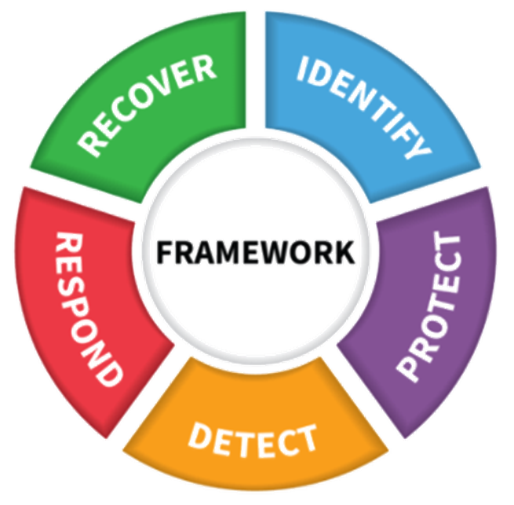
NIST Security Framework
Detect
Protect
Respond
Recover
Identify
https://www.nist.gov/cyberframework
JG

Slide 9
Detect First Steps - Collection into Splunk
Network Logging
Zeek/Bro
Duo
Two-factor access
Syslog
Log forwarding to Security syslog collectors
Qualys
Vulnerability scanning
Host scanning across NCSA
JG

Slide 10
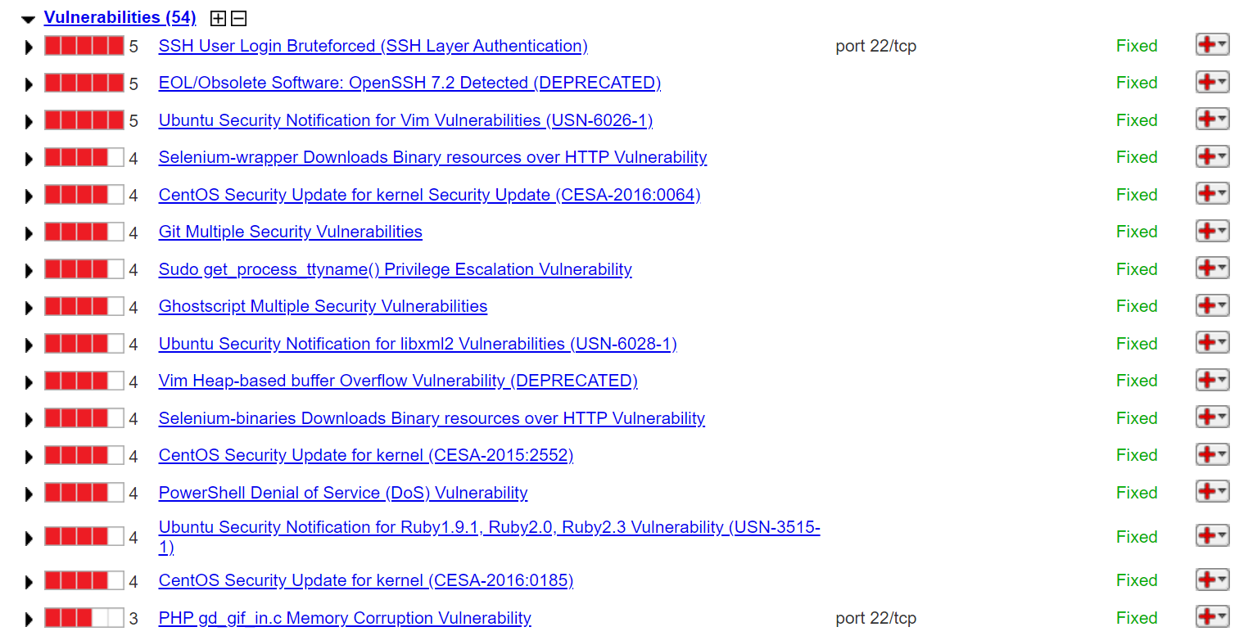
Examples - Qualys
JG

Slide 11
Examples - Zeek
1683666986.343287 CdhH7u1SHzwdK8cdgb 141.142.22.20 58862 128.174.180.5 88 TGS cclausen/AD.UILLINOIS.EDU krbtgt/AD.UILLINOIS.EDU T - - 2136422885.000000 aes256-cts-hmac-sha1-96 T T - - - -
1683666986.337335 Cf3L1SDlxXt6MNkS5 141.142.22.20 58861 128.174.180.5 88 TGS cclausen/AD.UILLINOIS.EDU krbtgt/AD.UILLINOIS.EDU T - - 2136422885.000000 aes256-cts-hmac-sha1-96 T T - - - -
1683666986.330237 CRSpIr27xd9FbI04L1 141.142.22.20 58860 128.174.180.5 88 TGS cclausen/AD.UILLINOIS.EDU krbtgt/AD.UILLINOIS.EDU T - - 2136422885.000000 aes256-cts-hmac-sha1-96 T T - - - -
1683666986.323069 CjFZqi49dDmkU7Czwd 141.142.22.20 58859 128.174.180.5 88 TGS cclausen/AD.UILLINOIS.EDU krbtgt/AD.UILLINOIS.EDU T - - 2136422885.000000 aes256-cts-hmac-sha1-96 T T - - - -
CC

Slide 12
Examples - Syslog
<86>May 9 16:17:01 ncsa-cdcx CRON[1292837]: pam_unix(cron:session): session closed for user root
<78>May 9 16:17:01 ncsa-cdcx CRON[1292838]: (root) CMD ( cd / && run-parts --report /etc/cron.hourly)
<86>May 9 16:17:01 ncsa-cdcx CRON[1292837]: pam_unix(cron:session): session opened for user root by (uid=0)
<86>May 9 16:15:01 ncsa-cdcx CRON[1292833]: pam_unix(cron:session): session closed for user root
<78>May 9 16:15:01 ncsa-cdcx CRON[1292834]: (root) CMD (command -v debian-sa1 > /dev/null && debian-sa1 1 1)
<86>May 9 16:15:01 ncsa-cdcx CRON[1292833]: pam_unix(cron:session): session opened for user root by (uid=0)
CC

Slide 13
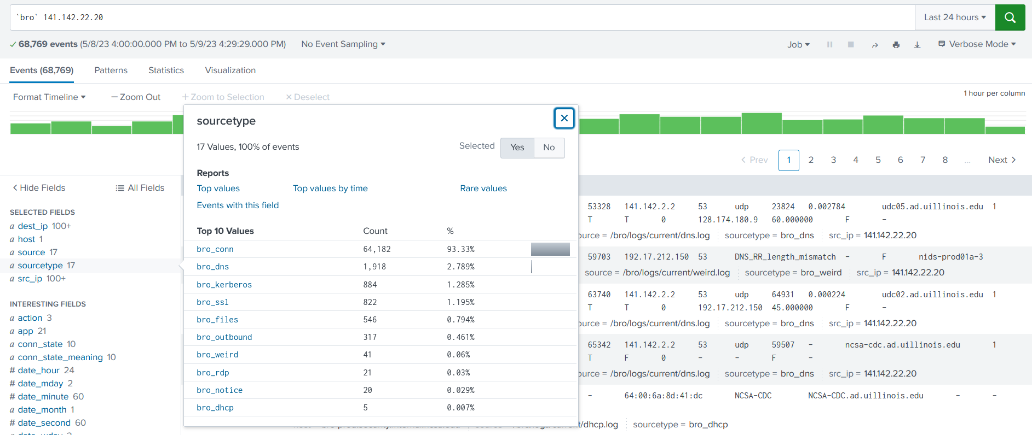
Splunk - Zeek Data
CC

Slide 14
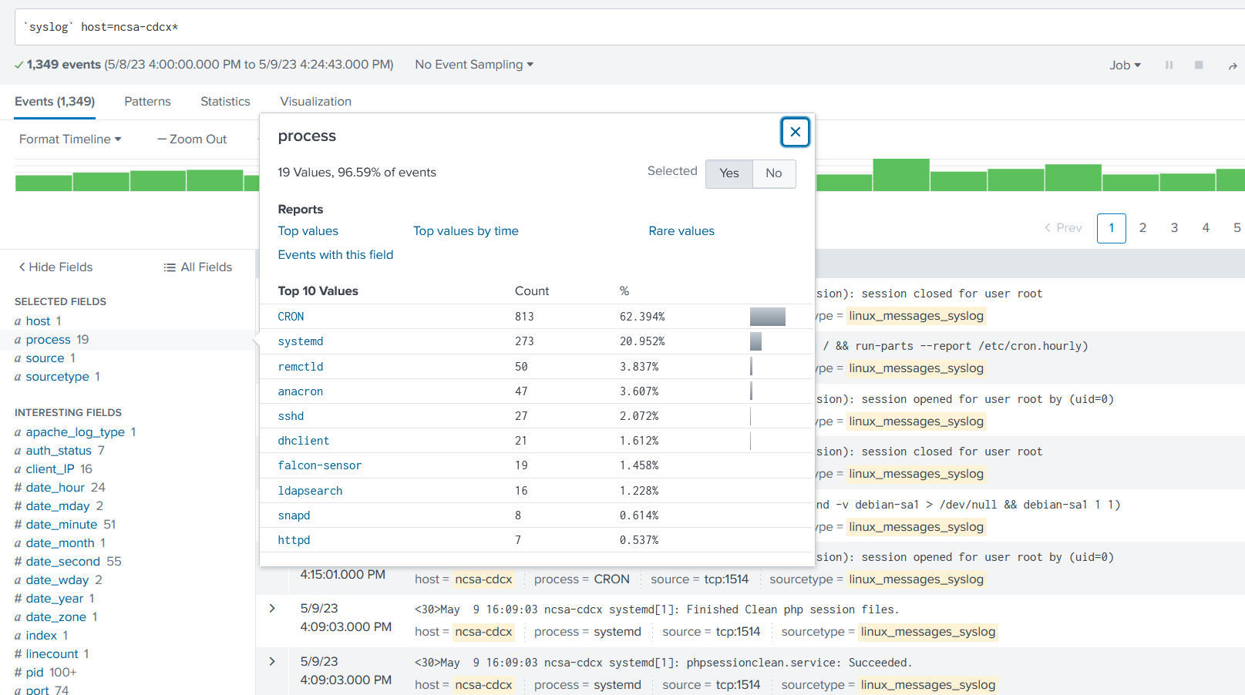
Splunk – Syslog Data
CC

Slide 15
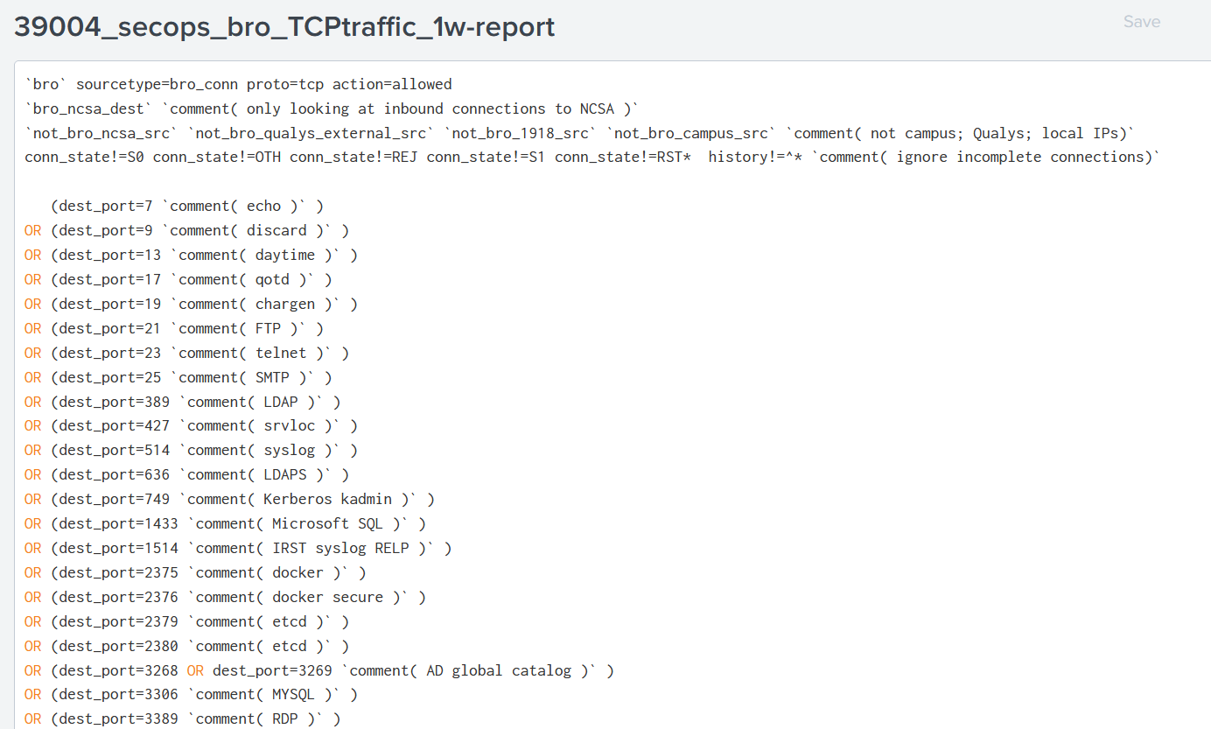
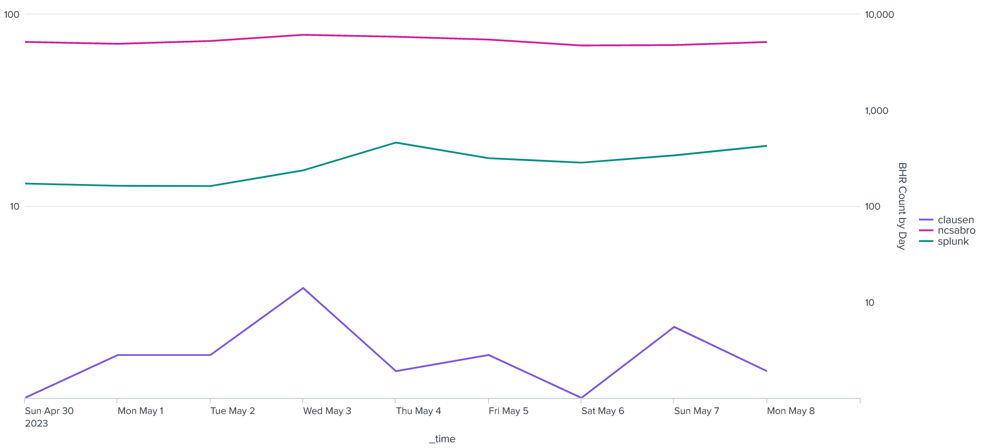
Splunk Data
CC

Slide 16
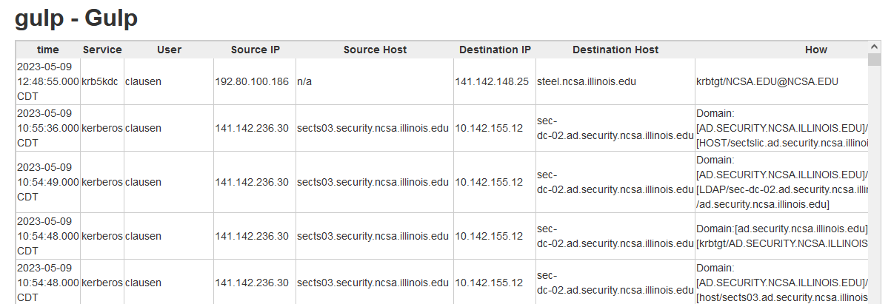
Detect & Protect - Analysis
Regular Splunk analysis of collected data
  Generate indexes
    GULP/GULP_Fail
    Krb_store
GULP
  Based on past Educause talk for grand unified logging
CC

Slide 17
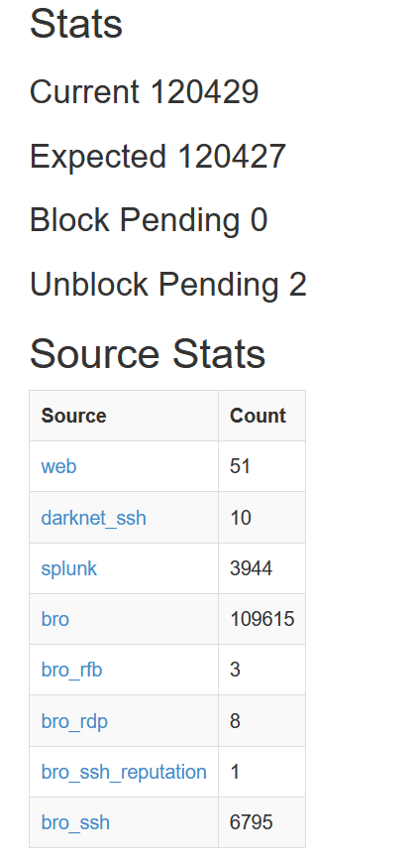
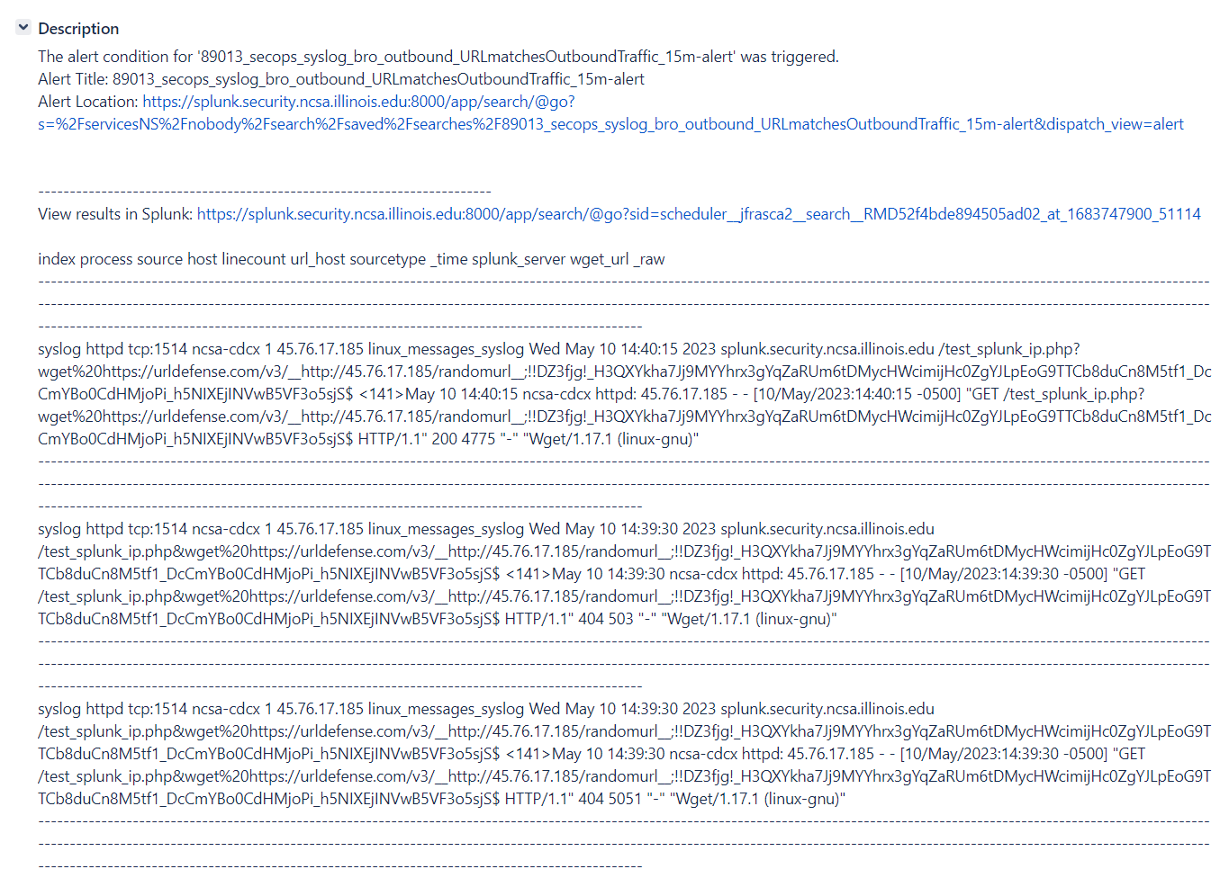
Detect & Protect - Alerting
Splunk can generate JIRA tickets and emails
Can also block determined bad traffic
  BHR
JG

Slide 18
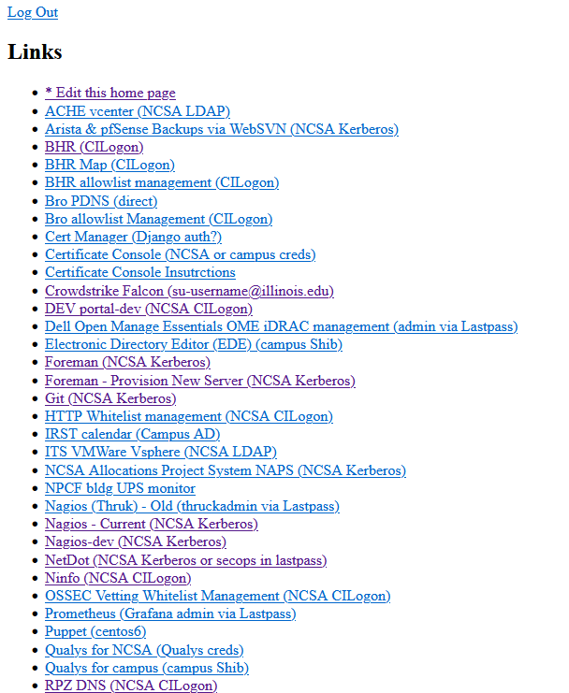
Respond - Investigation
Determine false positives
  Update alerting
More information review
  Security Portal
  User/admin outreach
Start remediation
  Data Gathering for forensics
JG

Slide 19
Recover - Remediation
Block assumed attackers/compromised hosts
Look for similar signs across NCSA
Steps to proactively prevent/detect in future
  Updating Detect & Protect
CC

Slide 20
Proactive Security

Slide 21
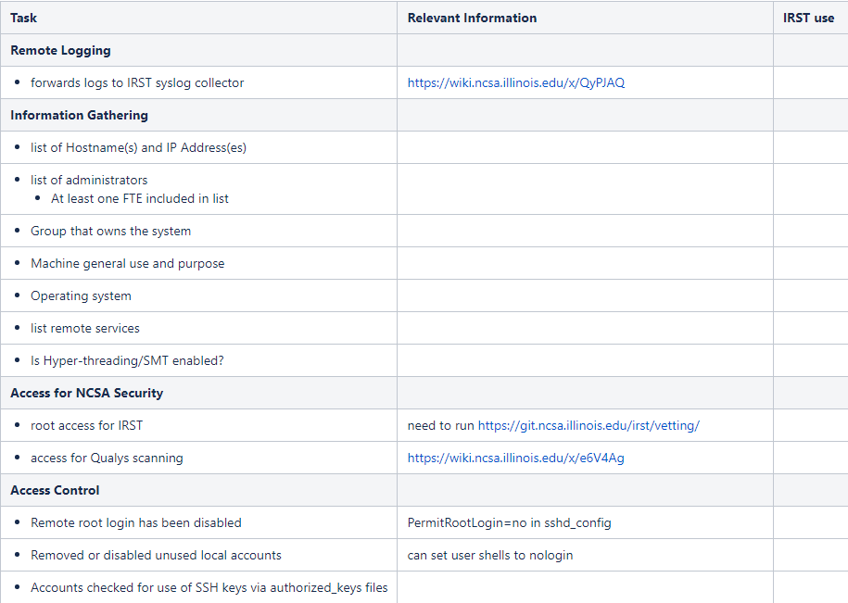
Security Vetting
Proactively review configs
  Goal is to reduce surface of attack
Both the host or application
Log forwarding
Qualys Scanning
Least Privilege
Defense in Depth
Security Vetting Checklist
JG

Slide 22
Matching Configurations: Avoiding Configuration Chaos
Goal is to have configurations line up
  Host OS Firewall (iptables, nftables, etc.)
  SSH config
  SSSD Config
  Access.conf
  Netstat (or ss)
  Application Configs
Various recommendations
https://wiki.ncsa.illinois.edu/x/6gjJAQ
JG

Slide 23
Common Findings/Previous Incidents

Slide 24
Common Findings/Previous Incidents
Open Services
Old hosts
Resource Misuse
Odd Download
Weak Passwords
CC

Slide 25
Questions?
help+security@ncsa.illinois.edu
Security Blog
#security-discussion in Slack

