Slide 1
Next Generation of
Apache Hadoop MapReduce
Arun C. Murthy - Hortonworks Founder and Architect
@acmurthy (@hortonworks)
Formerly Architect, MapReduce @ Yahoo!
8 years @ Yahoo!
June 29, 2011

Slide 2
Hello! I’m Arun…
Architect & Lead, Apache Hadoop MapReduce Development Team at Hortonworks (formerly at Yahoo!)
Apache Hadoop Committer and Member of PMC
  Full-time contributor to Apache Hadoop since early 2006

Slide 3
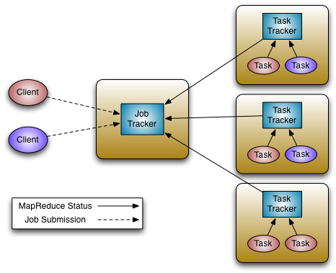
Hadoop MapReduce Today
JobTracker
  Manages cluster resources and job scheduling
TaskTracker
  Per-node agent
  Manage tasks

Slide 4
Current Limitations
Scalability
  Maximum Cluster size – 4,000 nodes
  Maximum concurrent tasks – 40,000
  Coarse synchronization in JobTracker
Single point of failure
  Failure kills all queued and running jobs
  Jobs need to be re-submitted by users
Restart is very tricky due to complex state
Hard partition of resources into map and reduce slots

Slide 5
Current Limitations
Lacks support for alternate paradigms
  Iterative applications implemented using MapReduce are 10x slower.
  Example: K-Means, PageRank
Lack of wire-compatible protocols
  Client and cluster must be of same version
  Applications and workflows cannot migrate to different clusters

Slide 6
Requirements
Reliability
Availability
Scalability - Clusters of 6,000-10,000 machines
  Each machine with 16 cores, 48G/96G RAM, 24TB/36TB disks
  100,000+ concurrent tasks
  10,000 concurrent jobs
Wire Compatibility
Agility & Evolution – Ability for customers to control upgrades to the grid software stack.

Slide 7
Design Centre
Split up the two major functions of JobTracker
  Cluster resource management
  Application life-cycle management
MapReduce becomes user-land library

Slide 8
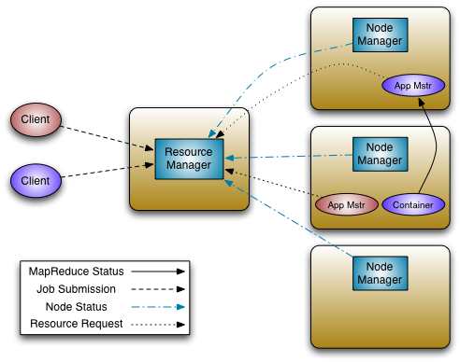
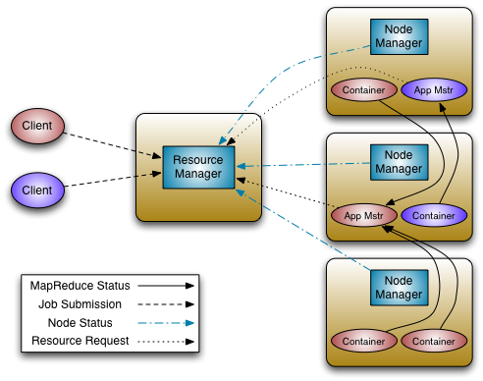
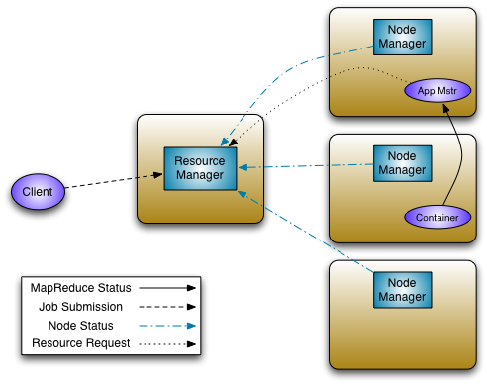
Architecture

Slide 9
Architecture
Resource Manager
  Global resource scheduler
  Hierarchical queues
Node Manager
  Per-machine agent
  Manages the life-cycle of container
  Container resource monitoring
Application Master
  Per-application
  Manages application scheduling and task execution
  E.g. MapReduce Application Master

Slide 10
Improvements vis-à-vis current MapReduce
Scalability
  Application life-cycle management is very expensive
  Partition resource management and application life-cycle management
  Application management is distributed
  Hardware trends - Currently run clusters of 4,000 machines
    6,000 2012 machines > 12,000 2009 machines
    <16+ cores, 48/96G, 24TB> v/s <8 cores, 16G, 4TB>

Slide 11
Improvments vis-à-vis current MapReduce
Fault Tolerance and Availability
  Resource Manager
    No single point of failure – state saved in ZooKeeper
    Application Masters are restarted automatically on RM restart
    Applications continue to progress with existing resources during restart, new resources aren’t allocated
  Application Master
    Optional failover via application-specific checkpoint
    MapReduce applications pick up where they left off via state saved in HDFS

Slide 12
Improvements vis-à-vis current MapReduce
Wire Compatibility
  Protocols are wire-compatible
  Old clients can talk to new servers
  Rolling upgrades

Slide 13
Improvements vis-à-vis current MapReduce
Innovation and Agility
  MapReduce now becomes a user-land library
  Multiple versions of MapReduce can run in the same cluster (a la Apache Pig)
    Faster deployment cycles for improvements
  Customers upgrade MapReduce versions on their schedule
  Users can customize MapReduce e.g. HOP without affecting everyone!

Slide 14
Improvements vis-à-vis current MapReduce
Utilization
  Generic resource model
    Memory
    CPU
    Disk b/w
    Network b/w
  Remove fixed partition of map and reduce slots

Slide 15
Improvements vis-à-vis current MapReduce
Support for programming paradigms other than MapReduce
  MPI
  Master-Worker
  Machine Learning
  Iterative processing
  Enabled by allowing use of paradigm-specific Application Master
  Run all on the same Hadoop cluster

Slide 16
Summary
MapReduce .Next takes Hadoop to the next level
  Scale-out even further
  High availability
  Cluster Utilization
  Support for paradigms other than MapReduce

Slide 17
Status – June, 2011
Feature complete
Rigorous testing cycle underway
  Scale testing at ~500 nodes
    Sort/Scan/Shuffle benchmarks
    GridMixV3!
  Integration testing
    Pig integration complete!
Coming in the next release of Apache Hadoop!
Beta deployments of next release of Apache Hadoop at Yahoo! in Q4, 2011

Slide 18
Questions?
http://developer.yahoo.com/blogs/hadoop/posts/2011/02/mapreduce-nextgen/

Slide 19
Thank You.

