Slide 1
Taking the Science of Climate Change to Exascale
Don Wuebbles
Department of Atmospheric Sciences
University of Illinois
Urbana, IL
INRIA, Grenoble June 2011

Slide 2
The Science is Clear:
Climate change is one of the most important issues facing humanity
The scientific evidence clearly indicates that our climate is changing, and that human activities have been identified as the primary cause.
All major science organizations agree with this statement.
Notes:
No disagreement in peer reviewed literature
Powerful statements from every major professional science society and organization in the world
Powerful statements from the National Academies of Sciences (the leadership in science) for every major country
G8 + 5 other countries, May 2009: “The need for urgent action to address climate change is now indisputable.”

Slide 3
One of Many Examples
May 2009
National Academies of Sciences from the
G8 + 5 other countries
“The need for urgent action to address climate change is now indisputable.”
United States, France, Germany, Italy, Japan, UK, Canada, Russia, plus Brazil, China, India, Mexico, South Africa

Slide 4
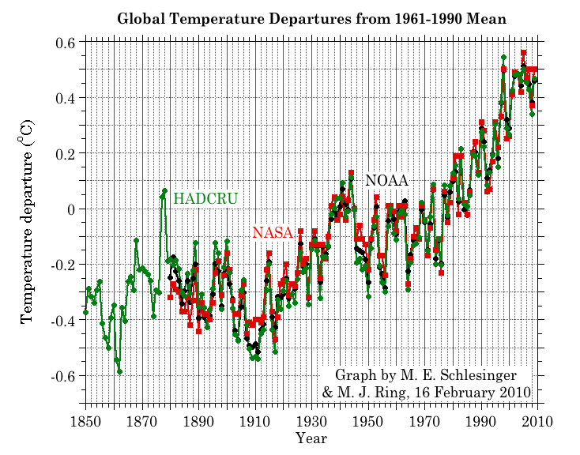
Three independent analyses of temperature record – Trends in close agreement

Slide 5
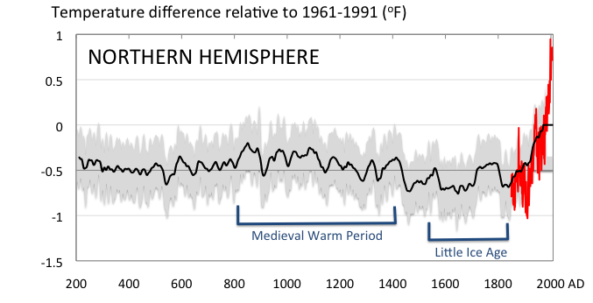
Conditions today appear to be unusual in the context of the last 2,000 years …
Mann et al., 2008 PNAS

Slide 6
Observed Indicators of a Globally Changing Climate
Temperature rise
Sea-level rise
Increase in heavy downpours
Rapidly retreating glaciers
Thawing permafrost
Lengthening growing season
Lengthening ice-free season in the ocean and on lakes
and rivers
Earlier snowmelt
Changes in river flows
Plants blooming earlier (1-3 days per decade earlier)
Animals, birds and fish moving northward

Slide 7
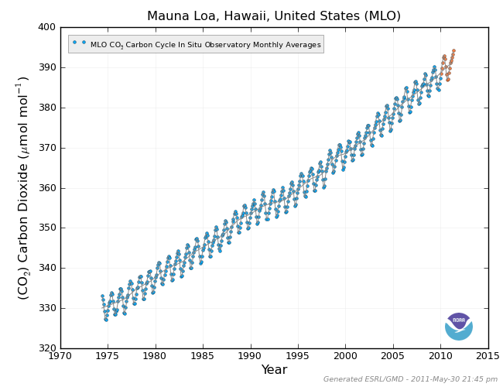
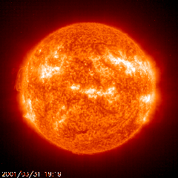
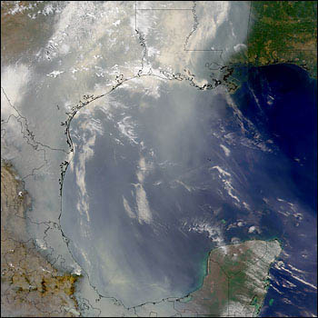
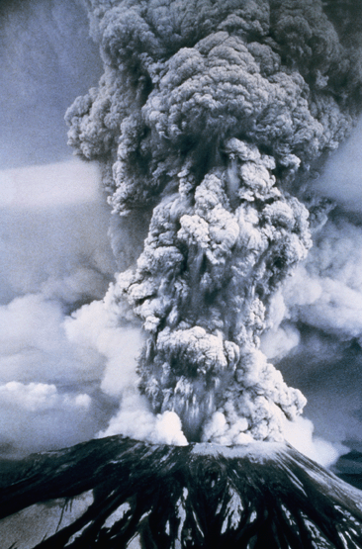
Natural Drivers of Climate
Human Factors in Climate
Variations in the Earth's orbit
(Milankovic effect)
Changes in atmospheric gases
Variations in the energy
received from the sun
Changes in particles from burning fossil fuels and biomass
Stratospheric
aerosols from
energetic
volcanic eruptions

Slide 8
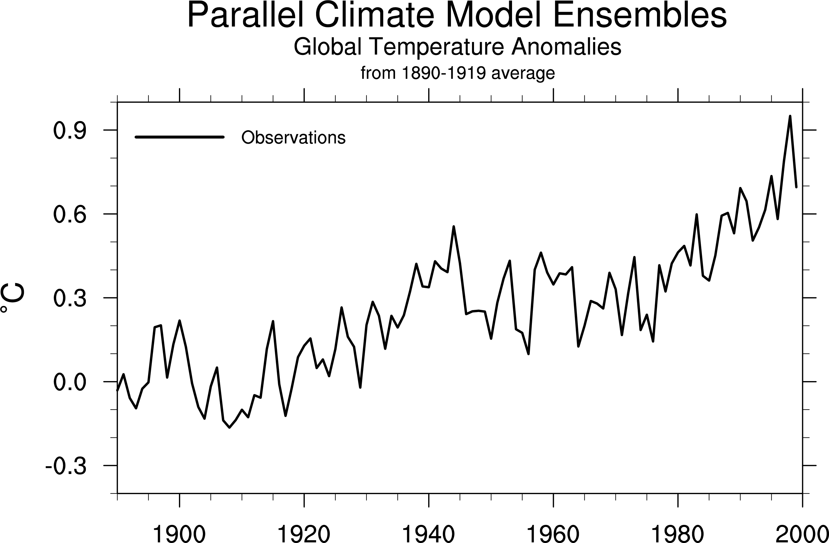
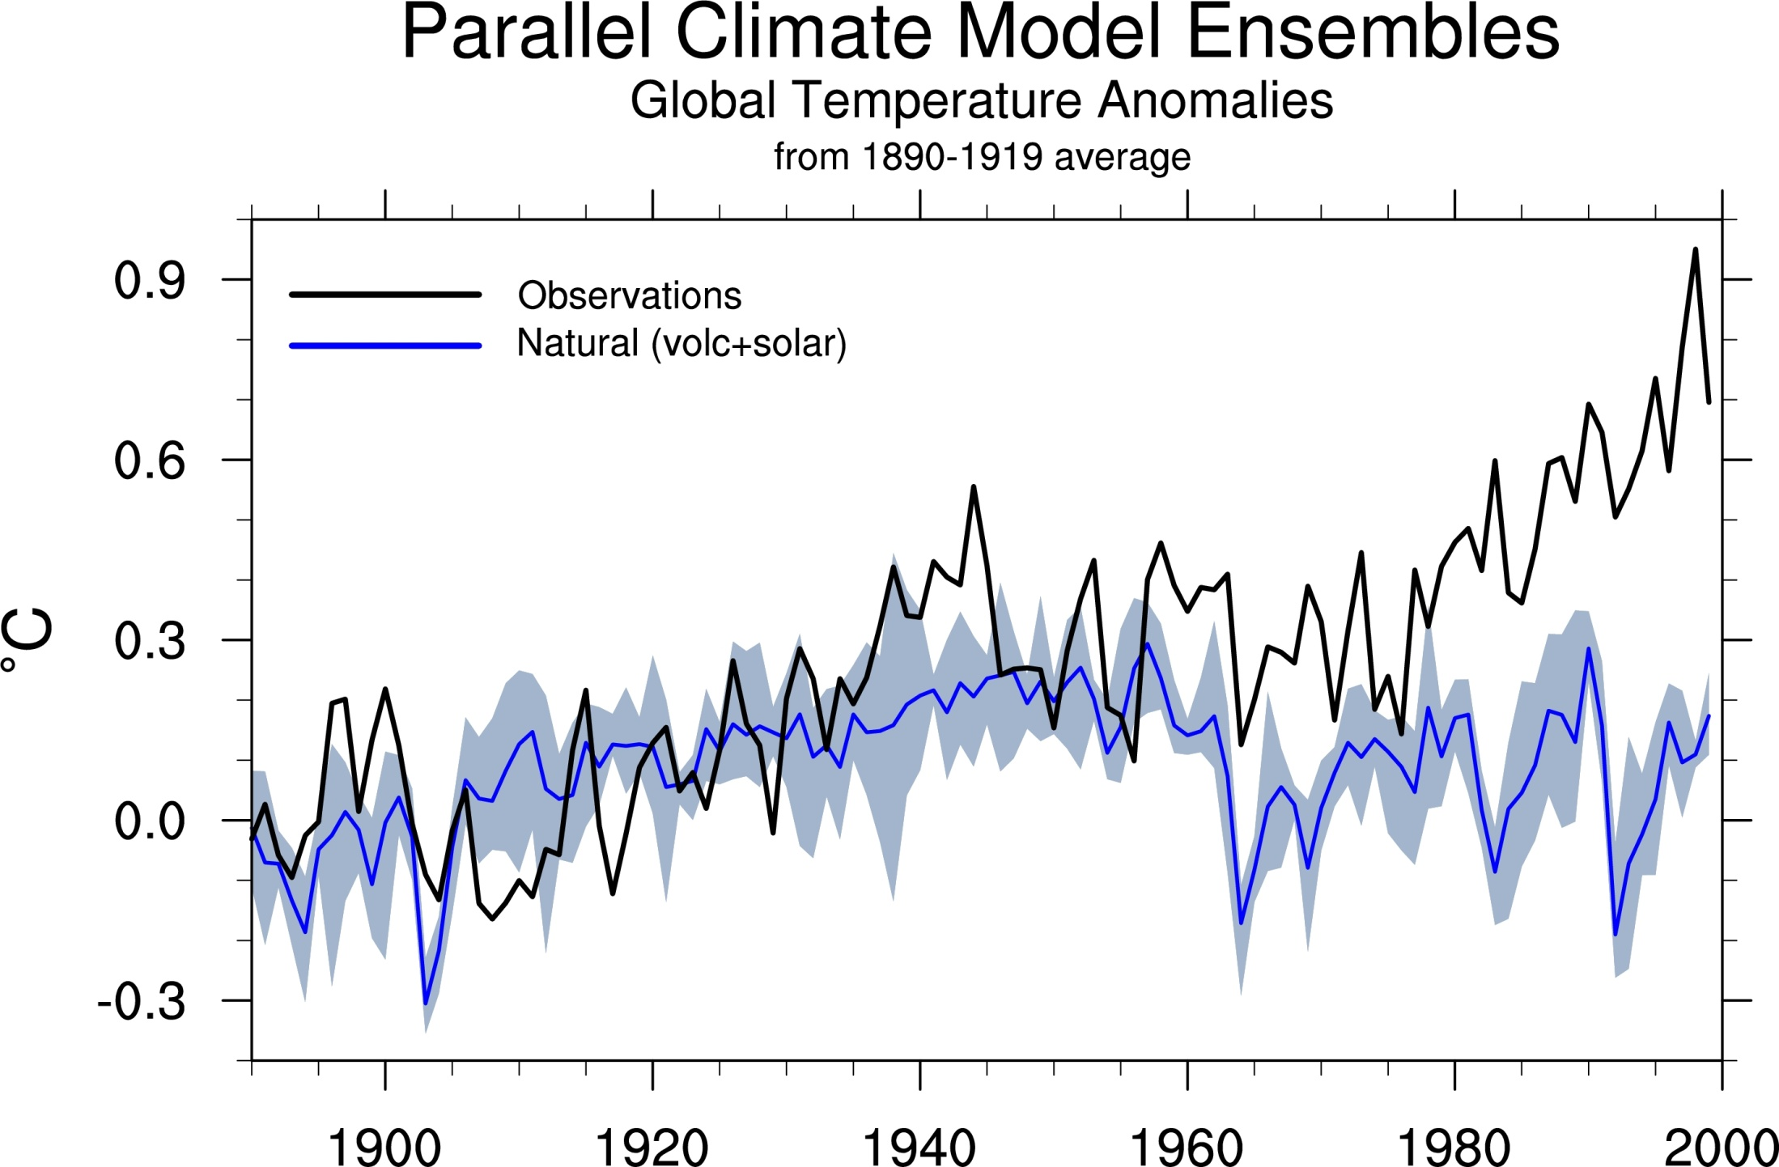
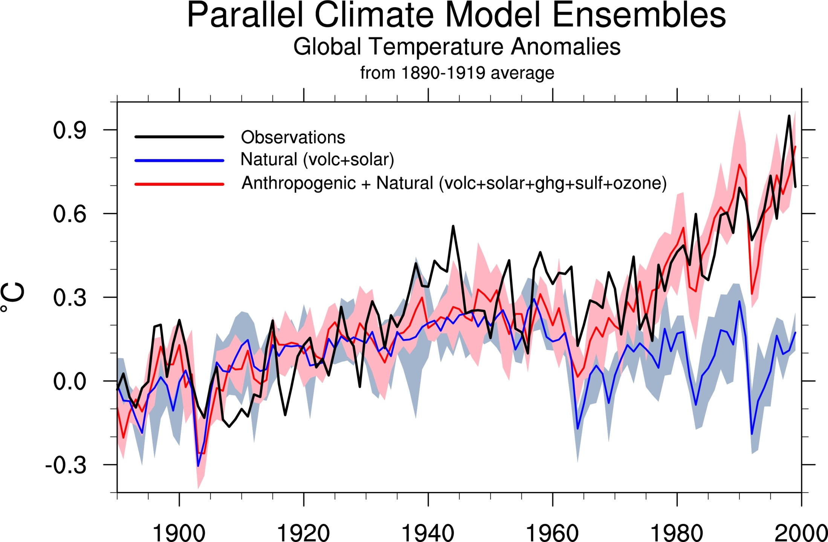
Climate models: Natural processes do not account for
observed 20th century warming after 1965
Models with natural effects (volcanoes and solar) only
Models with human and natural effects
Notes:
This slide shows the observed average global surface temperature anomalies (departures from the 1890-1919 average, black line) and complex three-dimensional global climate models with both natural (blue line) and anthropogenic (human, red line) effects. The natural effects include volcanoes and solar variability. The human effects include emissions of greenhouse gases (mostly carbon dioxide), ozone, and aerosols. The light red and blue envelopes around the red and blue lines show the range of temperatures produced by four different simulations with the same model, providing some indication of the model uncertainty.
This slide shows that climate models that account for human as well as natural effects can pretty well explain the observed temperature warming trend and variability, over the entire time period (1890-2000). However, models that include only natural effects show a significant and widening departure from the observations starting in the mid 1960s. This result provides strong evidence confirming the hypothesis that human activities are the main cause of global warming (the models cannot match the observations without including human effects; they produce climates that are too cold compared to observations). This slide, like the first one, also shows that other important natural processes and phenomena (such as El Niños) are going on from one year or even decades to the next. These natural effects cause the irregularities in the upward trend of temperature, as shown in the observations and the model results. Reference: G. Meehl, W. Washington and co-authors, 2004: Combinations of natural and anthropogenic forcings in twentieth century climate. Journal of Climate, p. 3721-3727

Slide 9
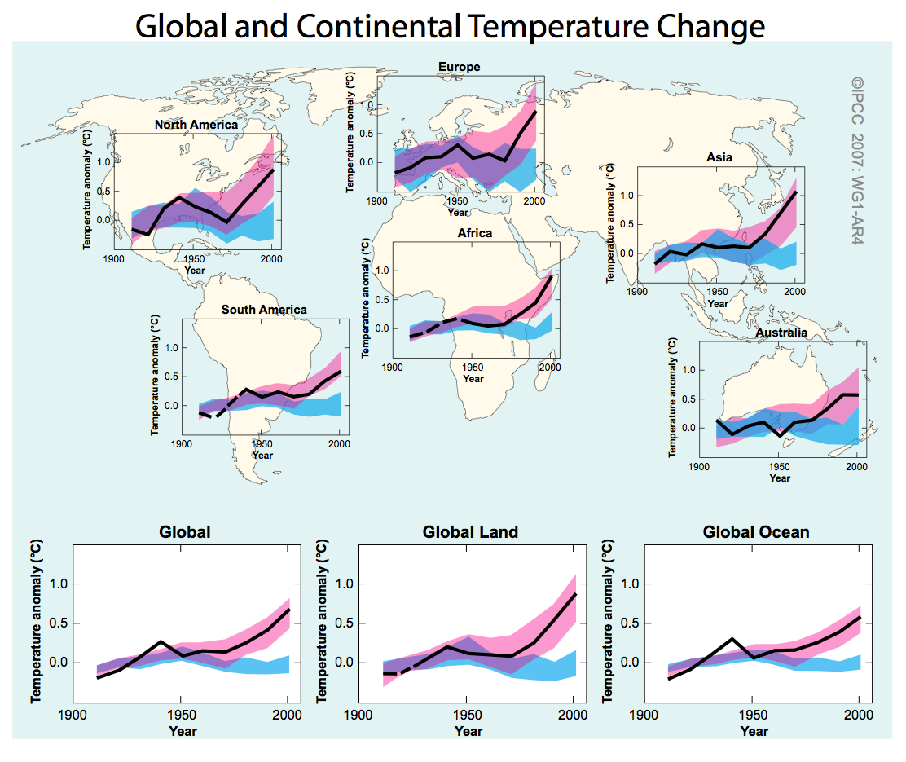
Blue is the model predictions without anthropogenic forcing
Pink is the model prediction with anthropogenic forcing
Black are the observations

Slide 10
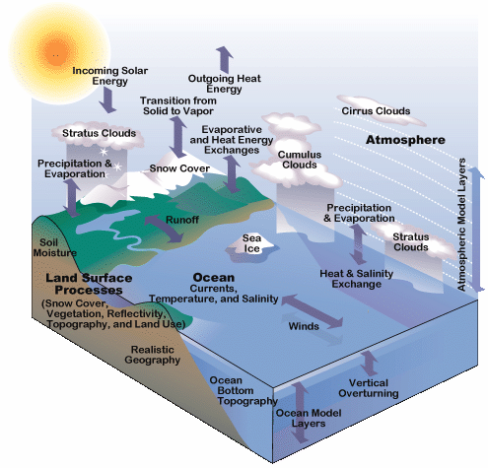
The Community Earth System Model
www.cesm.ucar.edu
Modeling the Earth System
A comprehensive hierarchy of models to:
  Explore Earth climate history and processes responsible for variability and change
  Estimate future of environment for policy formulation
  Treats all known processes in the Earth’s climate system
    Atmosphere
    Oceans
    Cryosphere
    Land
    Biosphere
    Water cycle
Developed by NCAR, Universities and National Laboratories

Slide 11
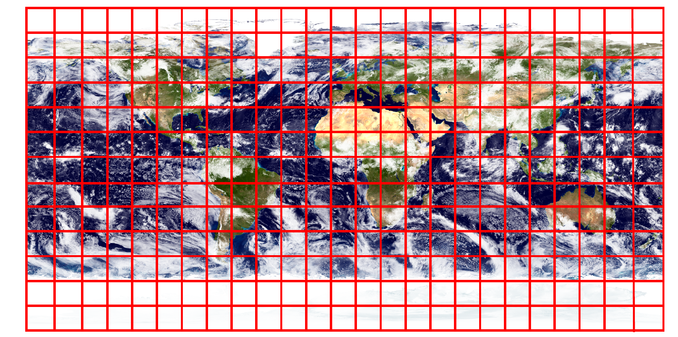
Numerical models of the atmosphere
Numerical models of the atmosphere are based on the physical laws of fluids.
Basic framework =
Spatial grid on which the equations of physics are represented
Red lines = lat/lon grid
Grid cell = smallest scale that can be resolved but many important process occurs on sub-grid scales
Courtesy: Peter Lauritzen

Slide 12
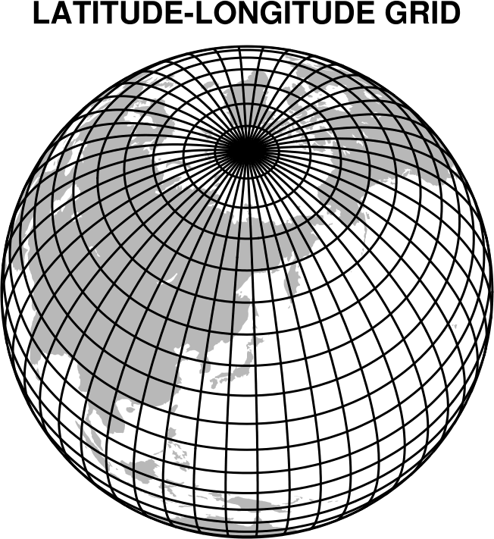
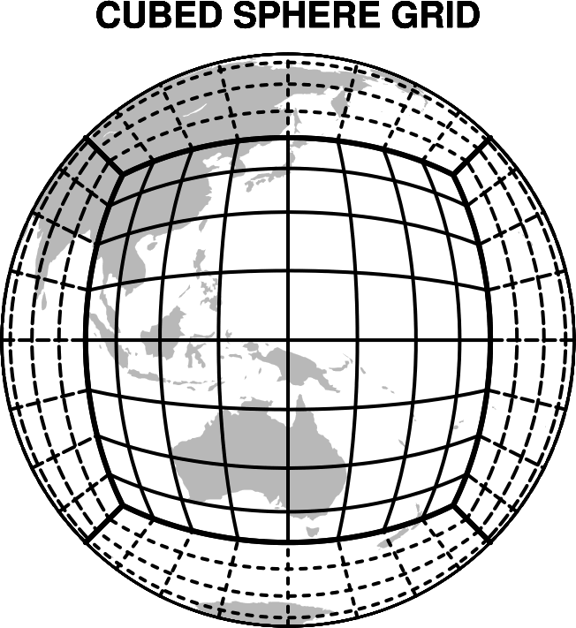
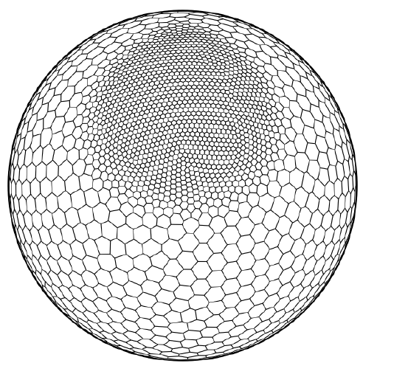
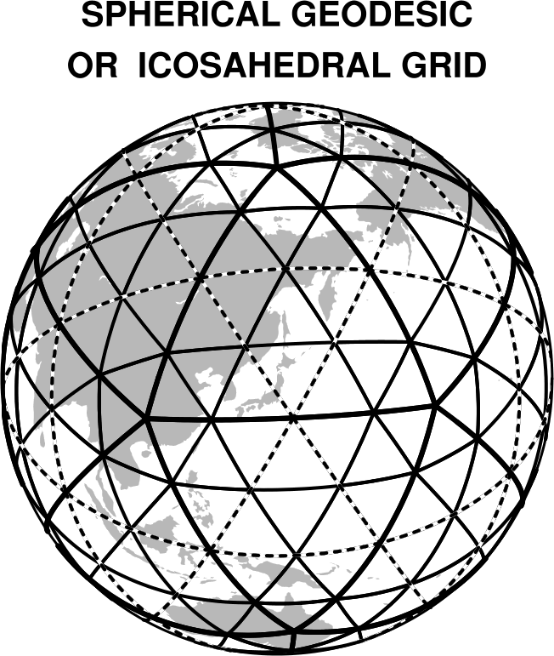
Atmospheric Model Grids
Problem near the poles
where longitudes converge
HOMME
Regional focus
MPAS
SPHERICAL CENTROIDAL VORONOI GRID (Hexagon)

Slide 13
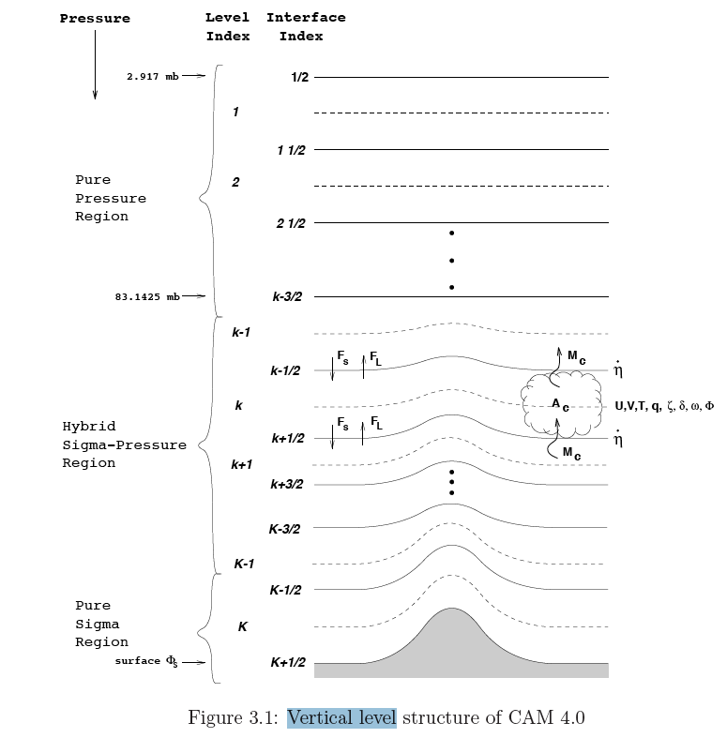
Vertical Model Grid
Model top:
CAM = 2 mbar - 40 km
WACCM = 10⁻⁶ mb - 100 km
Vertical resolution is also important for quality of simulations
Levels are not equally spaced (levels are closer near surface and near tropopause where rapid changes occurs)
In CAM: “hybrid” coordinate
- bottom: sigma coordinate (follows topography)
- top: pressure coordinate
- middle: hybrid sigma-pressure
2.9 mbar
Pure pressure
region
83 mbar
Hybrid
sigma-pressure
region
~ 985 mbar
Pure sigma
region
Surface ~ 1000 mbar

Slide 14
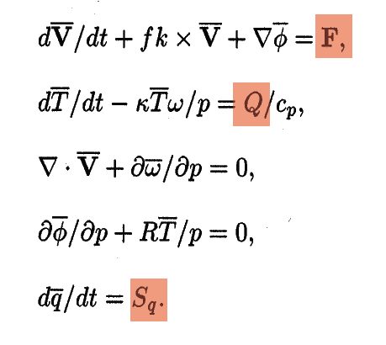
The Hydrostatic Primitive Equations
Simplified form of the equations of motion: the primitive equations
Momentum conservation:
Energy conservation:
Mass conservation:
Hydrostatic balance:
Water vapor conservation
Source and sinks
due to phenomena occurring on
scales smaller than grid resolution
Parameterized processes
or “the physics”

Slide 15
The hydrostatic primitive equations
Simplified form of the equations of motion: the primitive equations
  Atmosphere is assumed to be in hydrostatic balance (good for horizontal grid > 10 km)
  compression due to gravity is balanced by a pressure gradient force
  (involves ignoring acceleration in the vertical component of the momentum equations)
  Earth is assumed to be spherical and some other small terms in the momentum equations are neglected (atmosphere is thin compared to its horizontal extent)
Notes:
assumption that the horizontal scale is large compared to the vertical scale, such that the vertical pressure gradient may be given as the product of density times the gravitational acceleration.

Slide 16
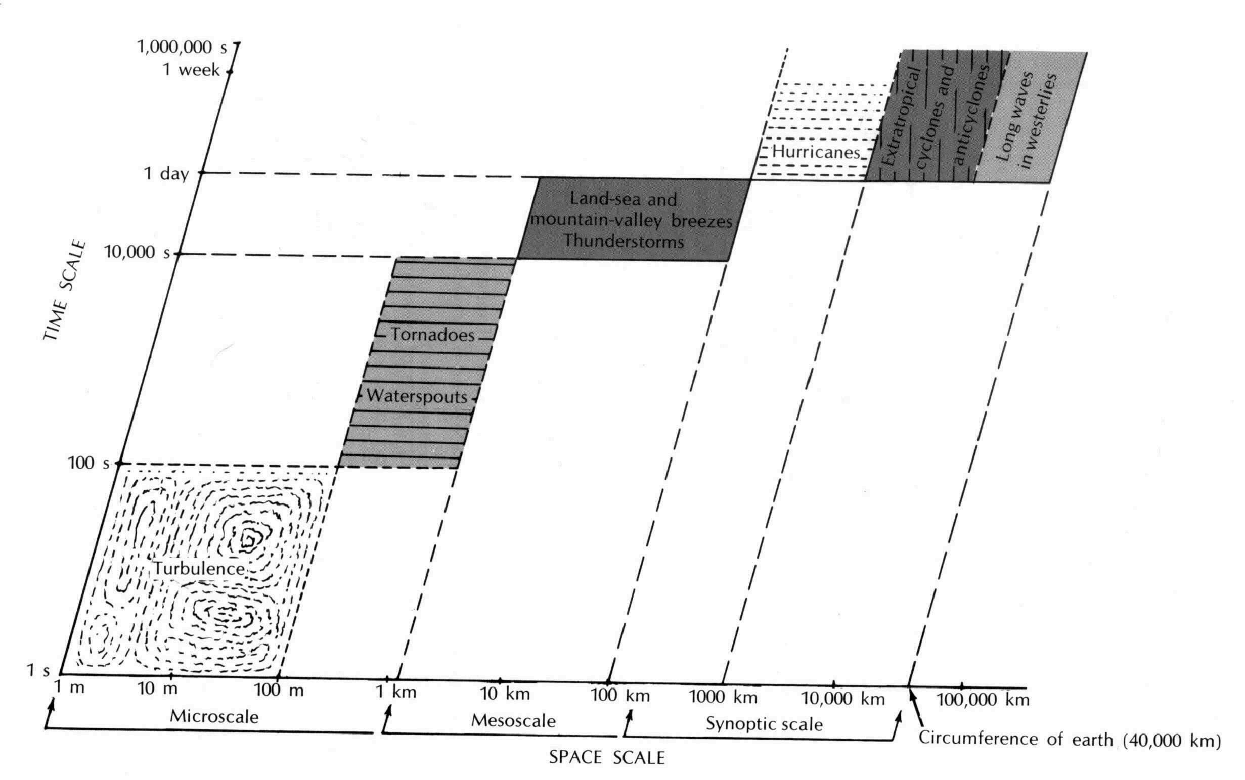
Scales of Atmospheric Processes
Important phenomena occurs at all scales.
Interactions between phenomena at different scales
=> very challenging

Slide 17
Physical parameterizations
Process of including the effect of unresolved phenomena
Usually based on:
    Basic physics (law thermodynamics)
    Empirical formulation from observations
Key parameterizations in atmospheric model:
  clouds
  radiation
  effects of unresolved turbulence and gravity waves
  effects of convection on heat, moisture and momentum budgets.
Behavior of model is critically dependent of these parameterization processes

Slide 18
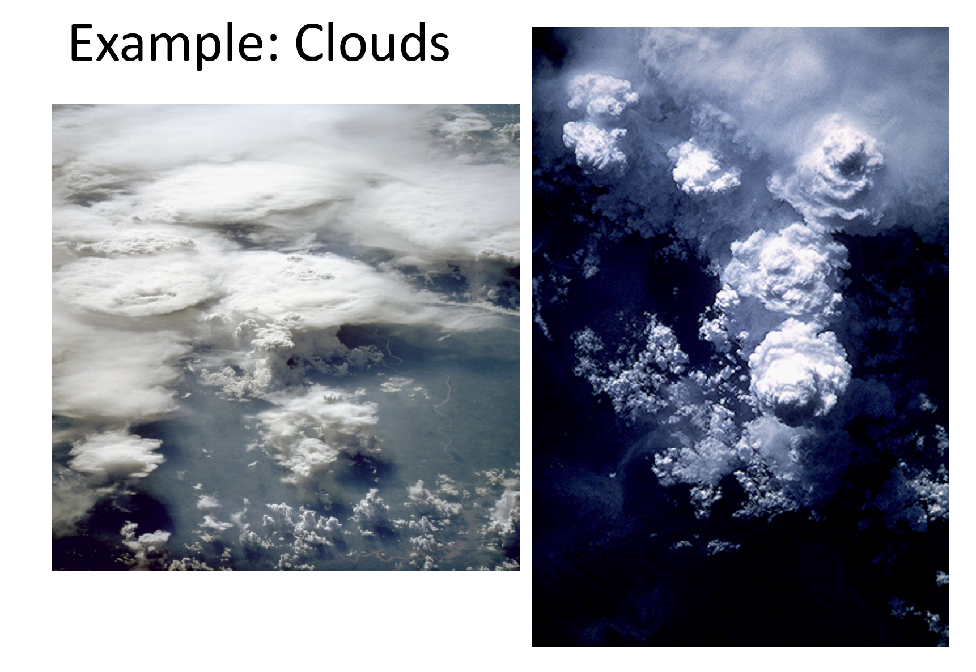
Sub-Grid Processes: Clouds
Need to represent:
Cloud formation and dissipation
Different types of clouds
Overlap of clouds
Convection in clouds
Precipitation
Courtesy: Andrew Gettelman

Slide 19
The Community Atmospheric Model (CAM)
Model | CAM3 | CAM4 | CAM5
Release | June 2004 | April 2010 | June 2010
Shallow Convection | Hack (1994) | Hack (1994) | Park et al. (2009)
Deep Convection | Zhang and McFarlane (1995) | Neale et al. (2008) | Neale et al. (2008)
Microphysics | Rasch and Kristjansson (1998) | Rasch and Kristjansson (1998) | Morrison and Gettelman (2008)
Macrophysics | Rasch and Kristjansson (1998) | Rasch and Kristjansson (1998) | Park et al. (2011)
Radiation | Collins et al. (2001) | Collins et al. (2001) | Iacono et al. (2008)
Aerosols | Bulk Aerosol Model | Bulk Aerosol Model BAM | Modal Aerosol Model Ghan et al. (2011)
Dynamics | Spectral | Finite Volume | Finite Volume
= New parameterization

Slide 20
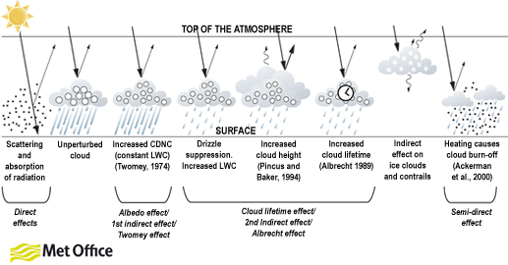
Anthropogenic Aerosol Effects
Previous Generation Model
Present Generation (CESM)
New cloud microphysics and aerosol treatment permit the study of Aerosol Indirect Effects

Slide 21
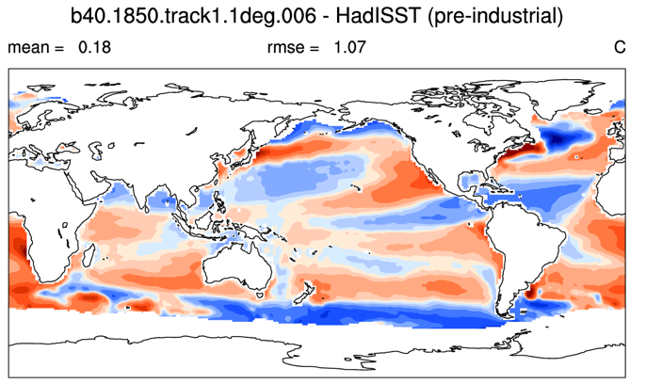
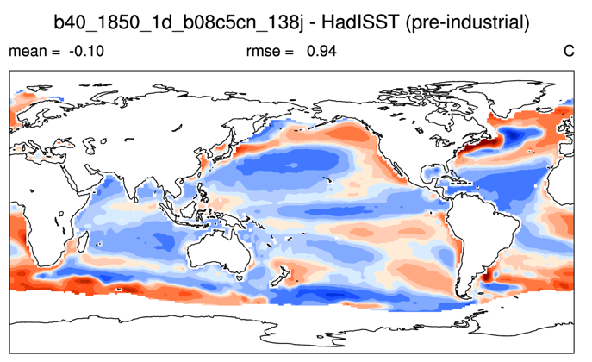
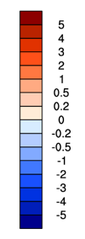
Sea-Surface Temperature: reduced errors
Sea Surface Temperature (SSTs) errors compared to Hurrell dataset
We use: Error = Model – Dataset
Root Mean Square Errors (RMSE) reduced in CAM5.1
Mean = 0.18
RMSE = 1.07
Mean = -0.10
RMSE = 0.94
CESM with CAM4
CESM with CAM5.1

Slide 22
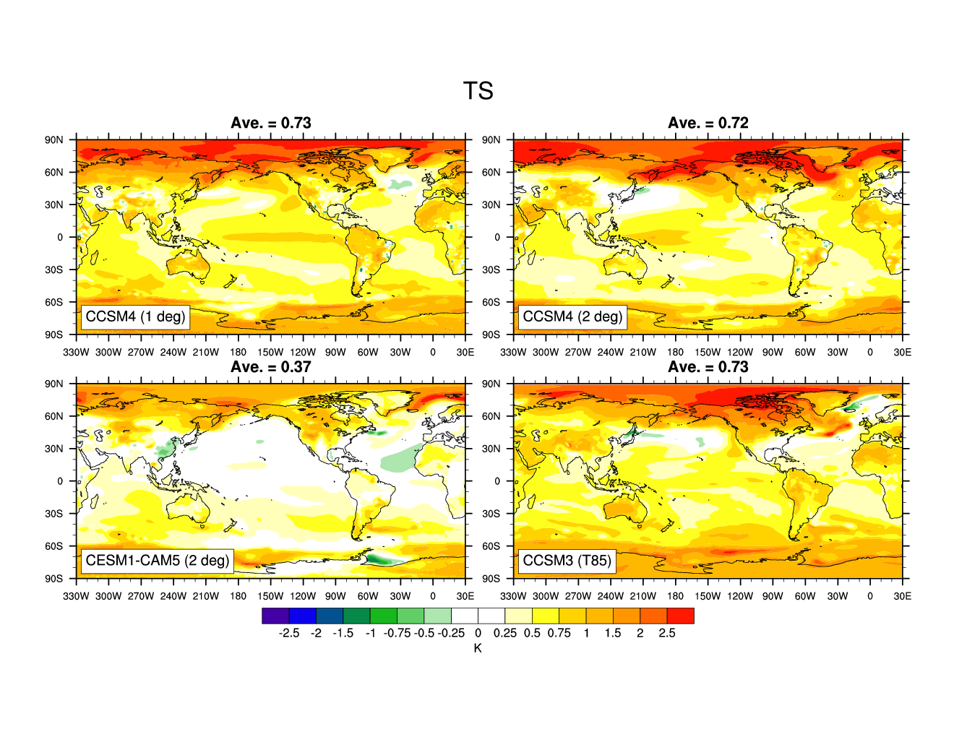
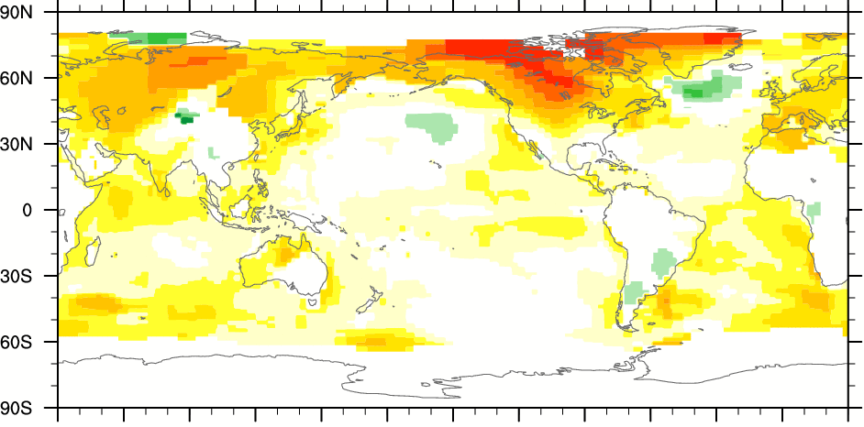
20th Century Surface Temperature Change
NO INDIRECT AEROSOL
OBSERVATIONS
Warming too strong

Slide 23
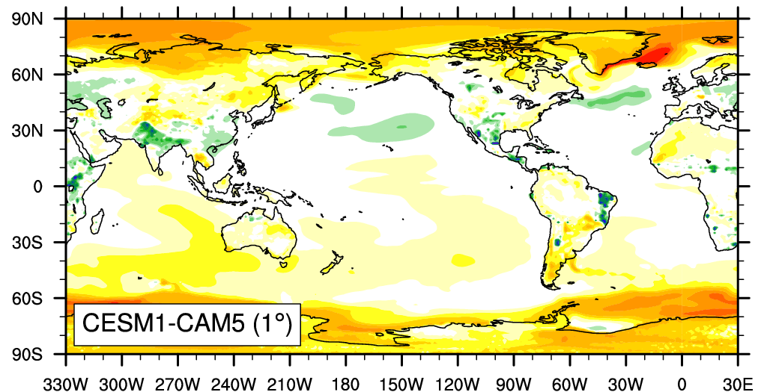
20th Century Surface Temperature Change
NO INDIRECT AEROSOL
OBSERVATIONS
WITH INDIRECT AEROSOL
More realistic regional temperature changes

Slide 24
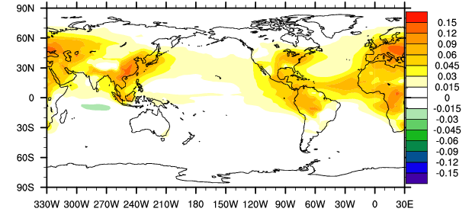
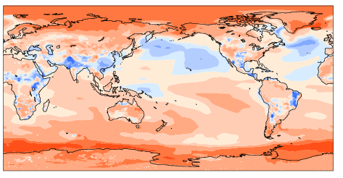
Impact of aerosol changes
Changes over the 20th century in CESM-CAM5
Increased aerosol burdens in SE Asia,
Europe, NE America
Aerosol have a cooling effect on climate
Significant regional modulation
of the general global warming trend
Total aerosol change (OD)
Surface temperature changes
CAM5 is able to address many science questions related to the impact of anthropogenic emissions on climate that were not previously possible.
Notes:
Aerosols are liquid or solid particles suspended in the air. They have a direct radiative forcing because they scatter and absorb solar and infrared radiation in the atmosphere.
CDNC (cloud droplet number conc.),
simulation with a minimum in-cloud droplet number of 20 per cc

Slide 25
Projections of Future Climate

Slide 26
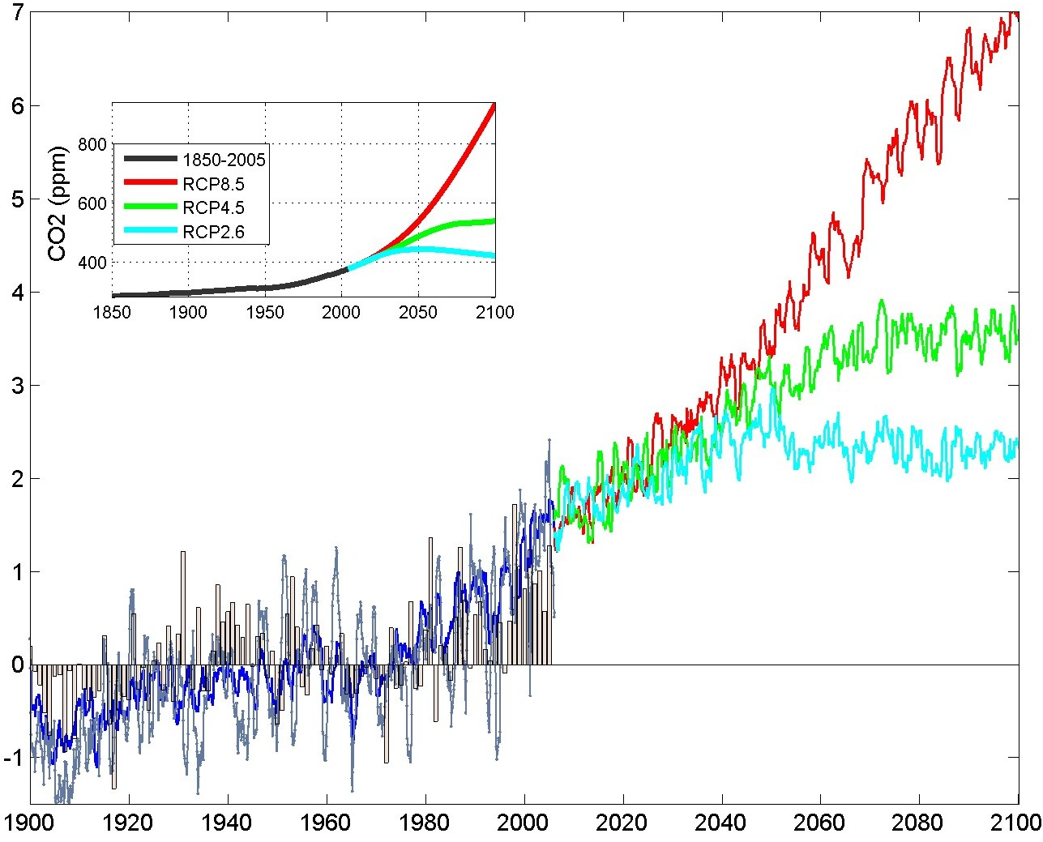
North American Annual Surface T (°C)
Business-as-usual
2 X CO2
CO2 close to today

Slide 27
North American Annual Surface T (°C)
Business-as-usual:
CO₂ more than doubled
Aggressive mitigation:
CO₂ close to today

Slide 28
Surface Temperature Change: 21st Century
RCP 2.6
RCP 4.5
RCP 8.5
2016 - 2035
2081-2100

Slide 29
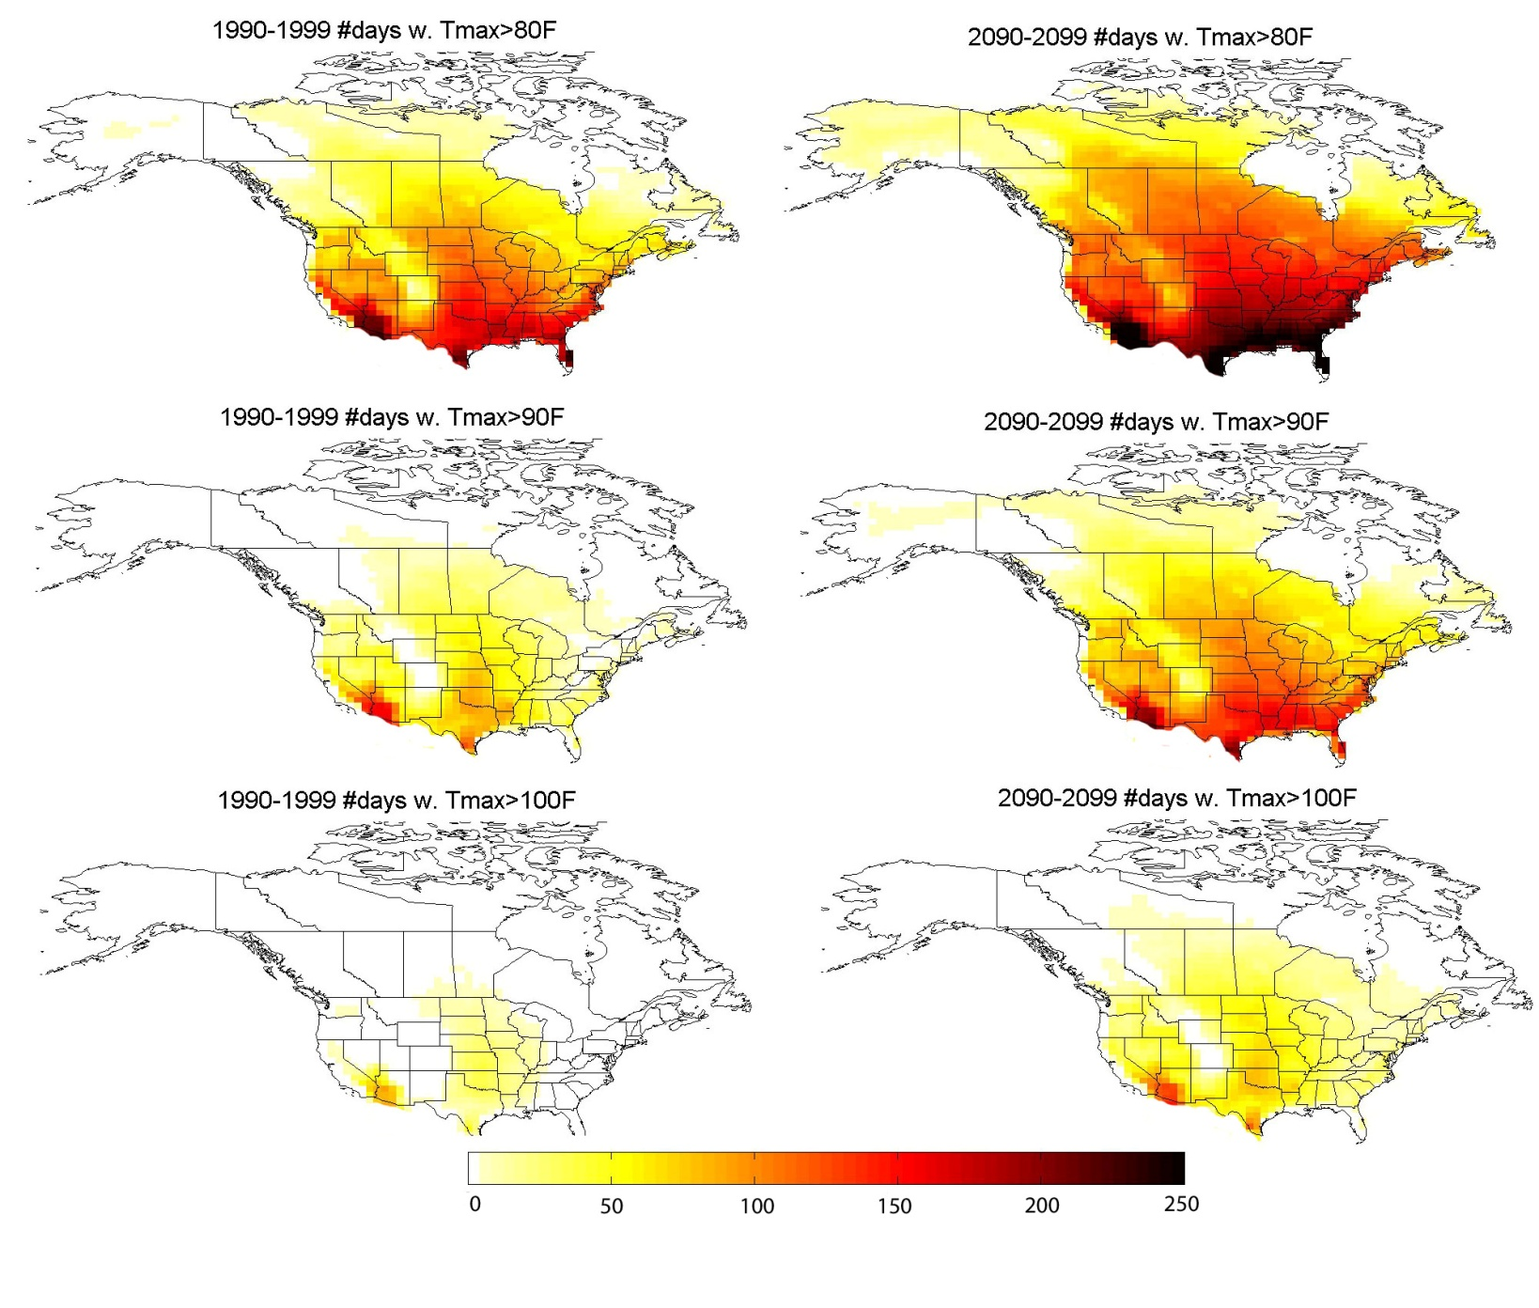
Extremes: Number of Warm Days
End of 20th Century
End of 21st Century
> 80ºF
> 90ºF
> 100ºF

Slide 30
Computational Challenges:
Increasing Model Complexity

Slide 31
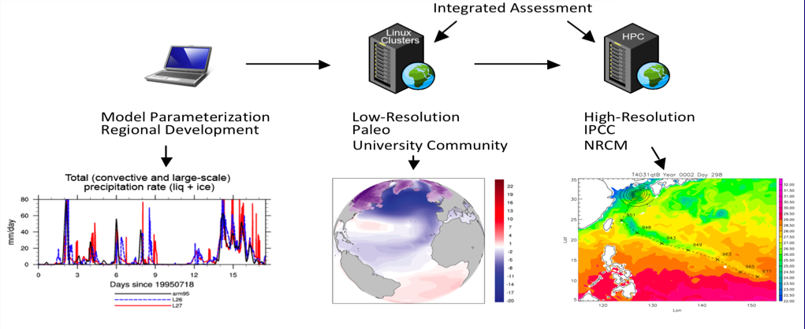
CESM1: Seamless End-to-End Cycle of Model Development, Integration and Prediction with
One Unified Model Code Base
Notes:
Using a single code base- you can do model parameterization and development on even a laptop – using the same code base the university community can carry out lower resolution runs on linux clusters – and using the same code base ultra high grand challenge simulations can be carried out on cutting edge hpc platforms.

Slide 32
The Complexity of a Climate Model
More components and new physics
  5 geophysical component models on different grids that exchange boundary data only via communication with a coupler
  New physics => larger number of fields exchanged more frequently between components
Larger code base
  ≈1.2 M lines of code (≈330K for CCSM3)
  Fortran 90 (mostly), developed over 20+ years
  200-300K lines are critically important
Increased critical collaborations
  DOE/SciDAC, University Community, CISL, NSF (PetaApps), ESMF>
  830 downloads of CESM1

Slide 33
Model Resolution Complexity
Ocean and Sea-Ice must run on same grid
  displaced pole, tripole
Atmosphere and Land can now run on different grids
  lat/lon, cubed sphere, new icosahedral
Globally grids span low resolution (3 degree) to ultra-high (0.125° ATM and 0.1° OCN/ICE)
Past grids were global and logically rectangular – now have regional, cubed sphere, icosahedral - moving to regionally refined
  Regridding issues are becoming a very high priority
Notes:
Mention again that in general the grids are global.
Atm grids in these in general are different from the ocean/ice grid

Slide 34
New CPL7 Architecture
processors
Original Multiple Executable CCSM3 architecture (cpl6)
time
CAM
CLM
CICE
POP
CPL
New Single Executable CESM1 architecture (cpl7)
Sequential Layout
Hybrid Sequential/Concurrent Layouts
Driver (controls time evolution)
Driver
CPL (regridding, merging)
CAM
POP
time
CAM
CLM
CPL
CICE
CLM
CICE
POP
processors
processors
Notes:
This is a sample hybrid layout. In the original ccsm3 system, each component ran as a separate executable and on a mutually exclusive set of processors. This works great if all the components truly run concurrently in time. But there is sequential dependence in time between the atmosphere, land and ice components. There is no flexibility in this system to account for this.

Slide 35
Advantages of CPL7
New flexible coupling strategy
CPL7 built as a single executable with a single high-level driver.
CPL7 consists of a driver that controls the top level sequencing, the processor decomposition, and communication to components through subroutine calls while coupler operations such as mapping and merging are running under the driver on a subset of processors.
The driver runs on all processors and handles coupler sequencing, model concurrency, and communication of data between components.
Supports a large set of architectures.
CPL7 targets massively parallel petascale hardware, smaller linux clusters, and even single processor laptops.
Supports varying levels of parallelism via simple run-time configuration for processor layout.
Notes:
Targets multiple architectures. Uses one XML file for layout. The coupling strategy permits us to support a much larger set of architectures than in ccsm3. Since the model now can be layed out across processors very easily from one xml file. It can therefore support running on 1 pe with no mpi to thousands of pes with either pure mpi or hybrid openmp/mpi parallelism by just varying the contents of one file. We can therefore run on anything from a laptop to the largest peta-scale platform available today.

Slide 36
Load Balancing
Optimize throughtput and decrease idle cycles
1664 cores
3136 cores
1.53 SYPD
1664 cores
4028 cores
2.23 SYPD
CAM
CAM
CLM
CLM
CICE
CICE
POP
POP
Time
CPL7
Time
CPL7
Processors
Processors
Idle time/cores
Increase core count for POP
Reduced Idle time
SYPD = Simulated Years per Day
Courtesy of John Dennis

Slide 37
Future Directions:
New Capabilities and Higher Resolution

Slide 38
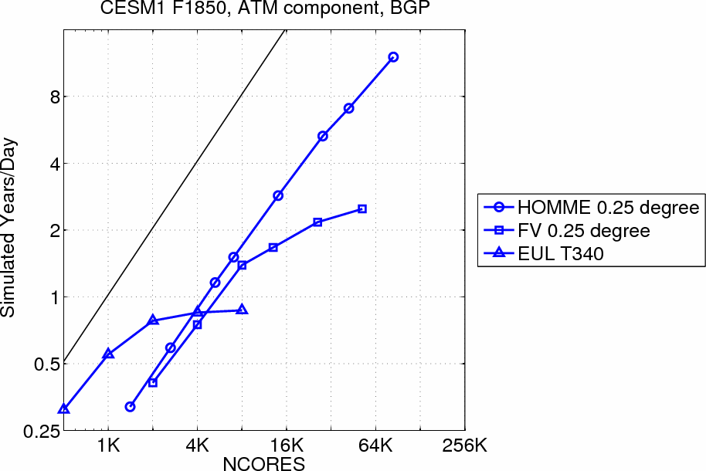

Preparing CESM for Petascale Computing
  Significant computing resources are being directed toward high resolution, climate-length runs (e.g., 25-km atmosphere and 0.1° ocean simulations for several decades)
  Higher resolution and regional mesh refinement in CESM1.0 (cubed sphere based dynamical core -- HOMME)
  Experiments with new NESL (MPAS) dynamical core underway

Slide 39
Dynamical cores in CAM
CAM3 (2004)
Eulerian dynamical core
Latitude/longitude grid
CAM4 and CAM5 (2010)
Finite volume dynamical core
Latitude/longitude grid
CAM5.2 (late 2011)
Spectral element dynamical core
HOMME (High-Order Method Modeling Environment)
Designed for fully unstructured grids (currently based on cubed sphere grid)

Slide 40
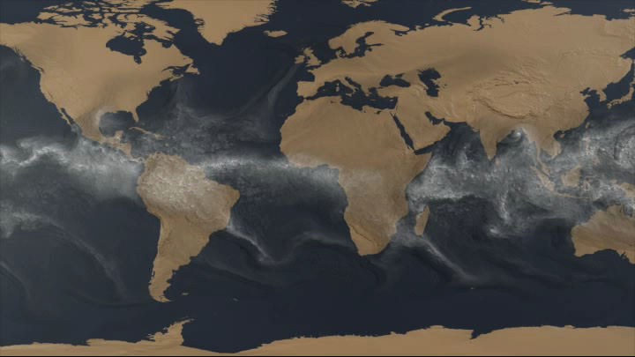
Precipitable water in CAM4 (1/8 degree)
Columns=3x10⁶
Simulation:
67,000 cores
At this resolution, hurricanes and typhoons become visible
Courtesy: Mark Taylor

Slide 41
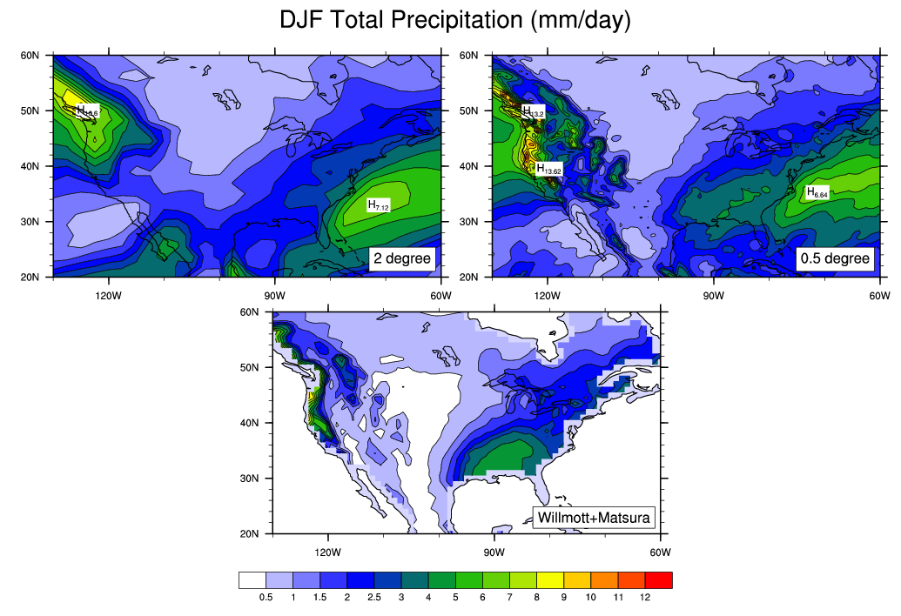
Resolution: Important to Model Accuracy
CCSM3.5
(last 20 years
of 20th century)
Observed

Slide 42
Ultra-High Resolution
Introduces new Requirements:
CPL7 infrastructure … and …
Memory scalability of all components
  Minimize global arrays
Performance scalability of all components
  Capability to use both MPI and OpenMP effectively to address requirements of new multi-core architectures
  ALL active components, CAM, CLM, CICE and POP2, meet this requirement
Parallel I/O throughout system

Slide 43
PIO in CESM1
Implemented in ALL component models
New asynchronous capability currently being added
Usage is critical for high resolution, high processor count simulations
  Pure old-style serial I/O is one of the largest sources of global memory in CCSM - will eventually always run out of memory
  New serial NetCDF I/O with PIO eliminates memory bottleneck
Notes:
Usage is critical since serial I/O has two major problems …

Slide 44
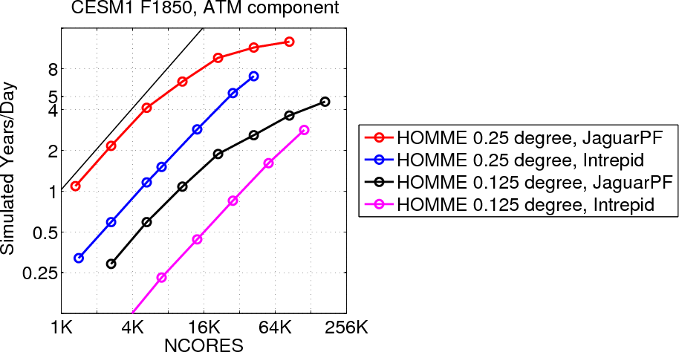
CCSM/HOMME Scalability
0.125° atm / 0.25° land / 0.1° docn
CCSM times include ALL CCSM components (PIO use was critical)
Scalability of the dynamical core is preserved by CAM and scalability of CAM is preserved by CCSM
Scale out to over 128K cores get 5 SYPD (Jaguarpf)
Work of Mark Taylor, Jim Edwards and Brian Eaton
Notes:
Largest bottleneck to parallel scalability is due to the latitude-longitude grid based dycores in the atmospheric model. This grid clusters points at the poles, creating a potential "pole problem”. There are highly effective techniques to deal with this pole problem, but the current techniques all adversely impact parallel scalability. Using a cubed-sphere grid is one potential way. HOMME contains several cubed-sphere dycores - the conservative spectral element model. HOMME dycore has been incorporated into CAM. NOT limit of scalability – the limit of what we have tried so far. Two important points to note – this work could not have been done without PIO and the aqua planet simulations give good scalability up to the order of 90K cores for 1/4 degree.
BGP (4 cores/node): Excellent scalability down to 1 element per processor (86,200 processors at 0.25 degree resolution).
JaguarPF (12 cores/node): 2-3x faster per core than BGP, scaling not as good - 1/8 degree run loosing scalability at 4 elements per process
Jaguarpf is a Cray XT5 at the National Center for Computational Sciences (NCCS) at Oak Ridge
National Laboratory (ORNL) that has 18,688 nodes of dual hex-core AMD
processors running at 2.6 Ghz with 16 GB of memory per node. The total
number of processors available is 224,256, and the interconnect uses a SeaStar
2+ router. Intrepid is an IBM Bluegene/P at Argonne National Laboratory (ANL)
with 163,840 850 MHz PowerPC 450 processors. There are 4 processors per
shared memory node, 1024 nodes per rack, and each node has 2 GB of
memory

Slide 45
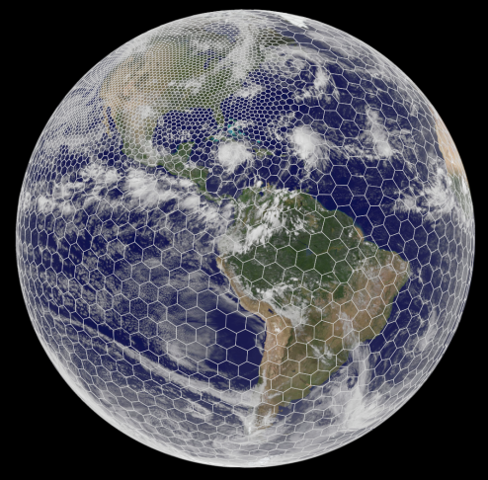
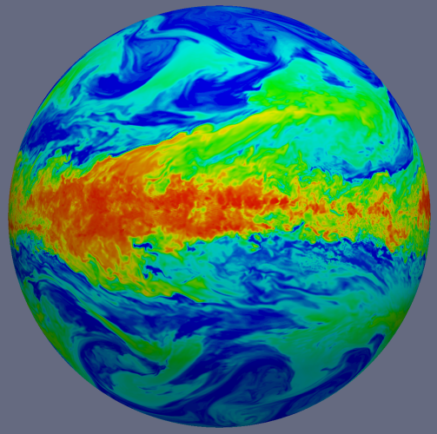
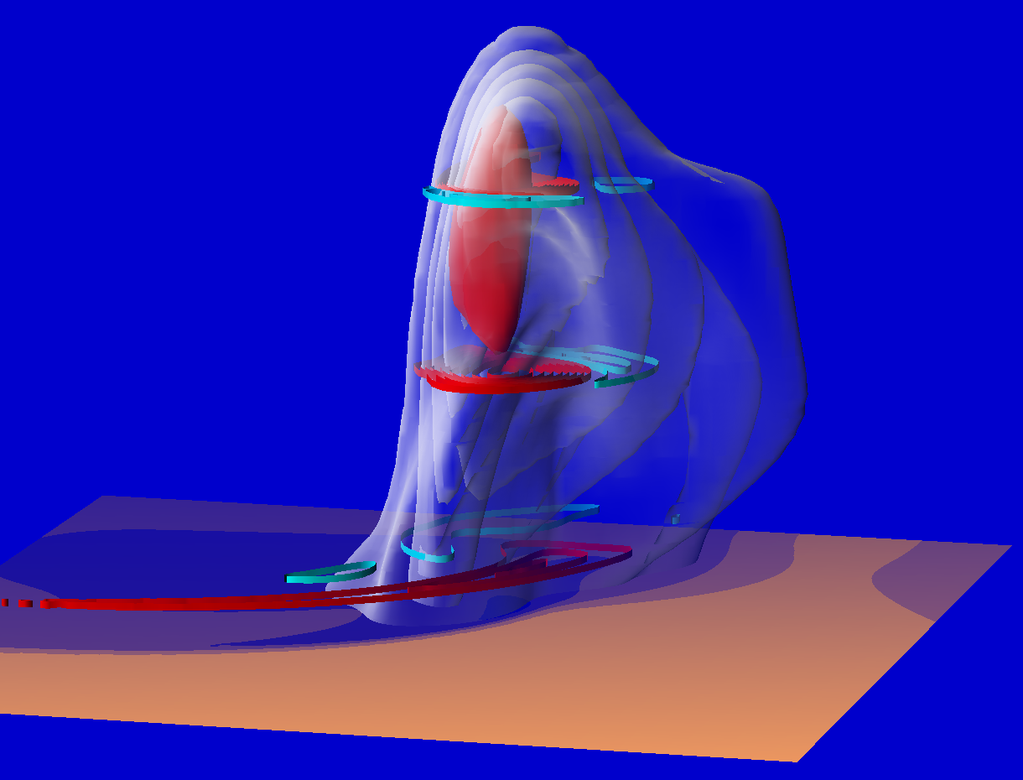
The Model for Prediction Across Scales
We are well advanced on developing the next-generation Model for Prediction Across Scales (MPAS)
Based on unstructured centroidal Voronoi (hexagonal) meshes using C-grid staggering and selective grid refinement
To be utilized for weather, regional and global climate applications.
  Currently being tested in the ocean model
Will allow for non-hydrostatic (< 10 km horizontal resolution)
Likely the eventual choice for exascale computing
Notes:
Top image is an example of the grid, with the telescope to high resolution over North America
Next is an aquaplanet simulation
Bottom is a supercell simulation at 500 m resolution

Slide 46
Thank You
www.cesm.ucar.edu
Courtesy: Mark Taylor

Slide 47
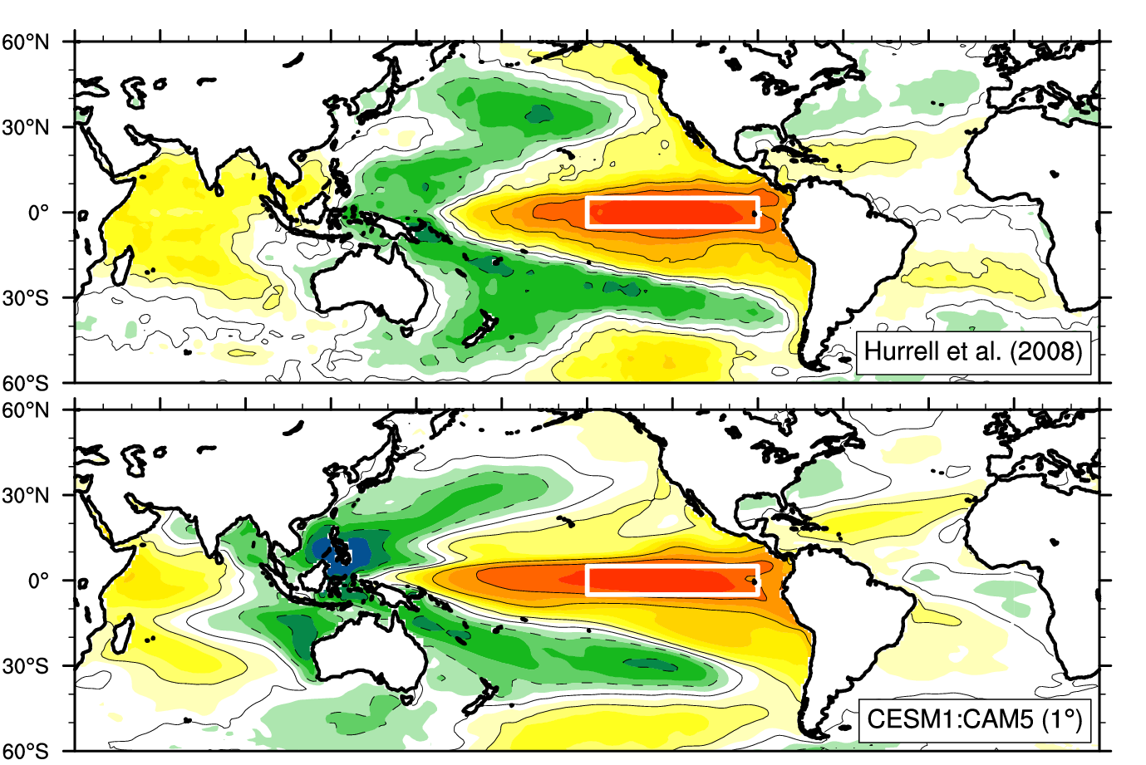
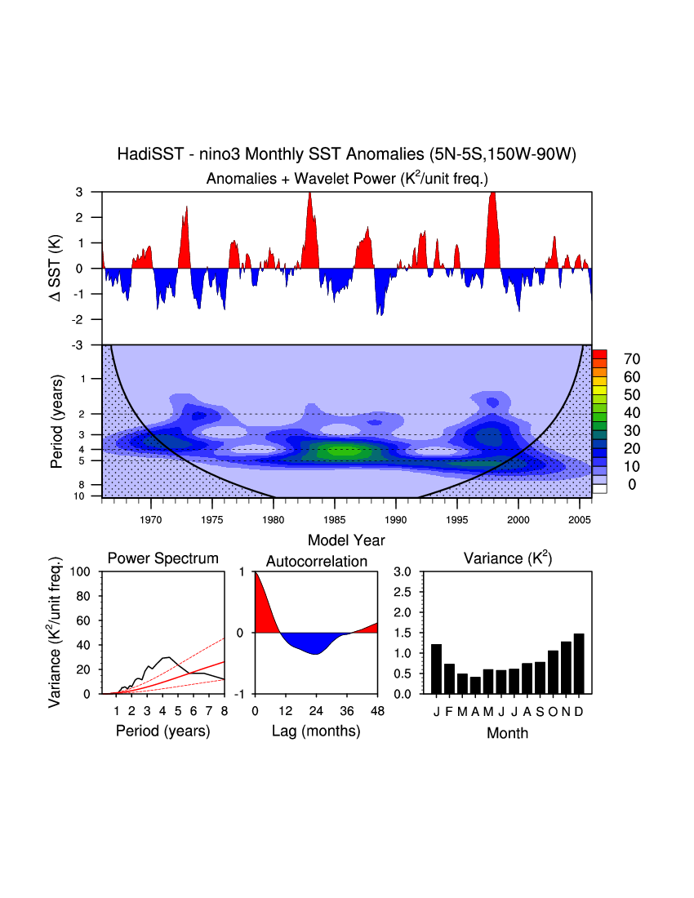
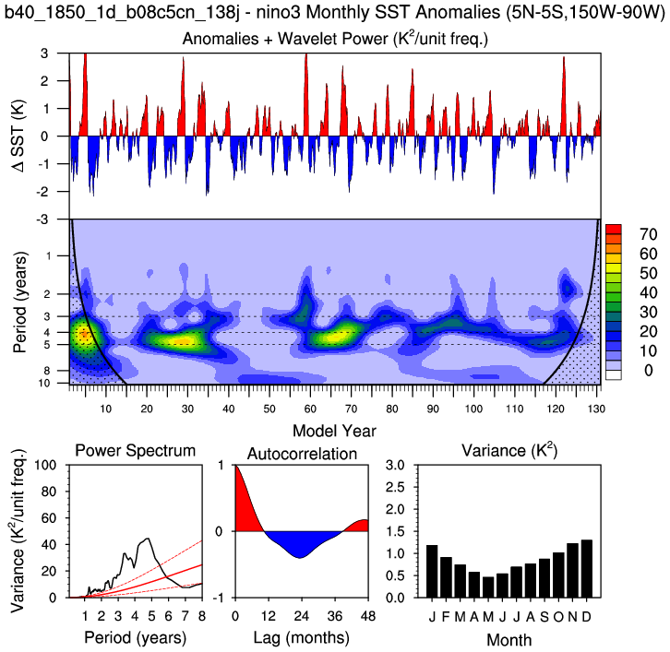
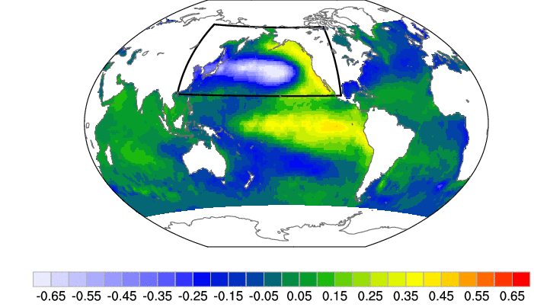
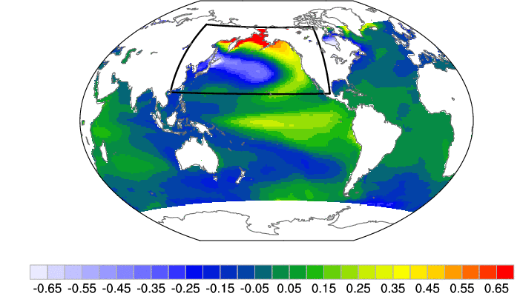
Pacific Variability: ENSO and PDO
PDO
PDO
Observations
CESM1 (CAM5)
Neale et al. (2008); Deser et al. (2011); Gent et al. (2011)

